Slide 1

A Multilayer Approach Towards Optimizing Spatial and Temporal Computing Systems
Erika Hunhoff
University of Colorado boulder
17 July 2025

Slide 2
Agenda
Introduction
Works
Freshen: Proactive Serverless Function Resource Management
Escra: Event-driven, Sub-second Container Resource Allocation
LD-NR and DiNOS: NUMA-Aware Replication for Dynamic Systems And An Operating System for a Shared Memory Rack
Extensions to IRON: Efficiency, Expressivity, and Extensibility in a Close-to-Metal NPU Programming Interface

Slide 3
Computing Stack
Application
Example: Image Processing
Framework
Example: Serverless
Runtime
Example: Containers
Operating System
Example: Linux
Hardware
Example: Neural Processing Units (NPUs)

Slide 4
Computing Stack
Application
Complicated Requirements
Example: Image Processing
Framework
Example: Serverless
Runtime
Example: Containers
Operating System
Example: Linux
Hardware
Example: Neural Processing Units (NPUs)
Complicated Architectures

Slide 5
Computing Stack
Abstractions and Interfaces
Layers
Application
Example: Image Processing
Framework
Example: Serverless
Runtime
Example: Containers
Operating System
Example: Linux
Hardware
Example: Neural Processing Units (NPUs)

Slide 6
Spatial and Temporal Characteristics
Application
Framework
Runtime
Operating System
Hardware

Slide 7
Spatial and Temporal Characteristics
Application
Framework
Runtime
Operating System
Hardware
Non-Uniform Memory Access (NUMA) Architectures

Slide 8
Spatial and Temporal Characteristics
Application
Framework
Runtime
Operating System
Threads, Scheduling, Task Granularity
Hardware
Non-Uniform Memory Access (NUMA) Architectures

Slide 9
Spatial and Temporal Characteristics
Application
Framework
Runtime
Operating System
Threads, Scheduling, Task Granularity
Hardware
Non-Uniform Memory Access (NUMA) Architectures

Slide 10
Spatial and Temporal Characteristics
Application
Logical Partitioning
Framework
Scaling Mechanisms
Runtime
Operating System
Hardware

Slide 11
Spatial and Temporal Characteristics
Application
Framework
Runtime
Operating System
Hardware

Slide 12
Serverless App
ML App
Application
4
1
Extensions to IRON
Programming Interface
Freshen
State Lifecycle
Serverless Framework
Framework
Container Runtime
Runtime
2
Escra
Auto-scaling
3
Linux
DiNOS
Operating System
LD-NR
Dynamic Replication
Hardware
CPU
CPU
NPU
Mem
Interconnect
Mem

Slide 13
For each layer…
Identify spatial and temporal characteristics
Spatial: Where computations occur affects performance
Temporal: When computations occur (often in context of other events) affects performance
Improve:
Efficiency (performance, resource utilization) and/or
Usability (management of complexity from the perspective of the programmer)

Slide 14
For each layer…
Identify spatial and temporal characteristics
Spatial: Where computations occur affects performance
Temporal: When computations occur (often in context of other events) affects performance
Improve:
Efficiency (performance, resource utilization) and/or
Usability (management of complexity from the perspective of the programmer)

Slide 15
Serverless App
ML App
Application
4
1
Extensions to IRON
Programming Interface
Freshen
State Lifecycle
Serverless Framework
Framework
Container Runtime
Runtime
2
Escra
Auto-scaling
3
Linux
DiNOS
Operating System
LD-NR
Dynamic Replication
Hardware
CPU
CPU
NPU
Mem
Interconnect
Mem
Agenda: Container-Based Cloud Services

Slide 16
Container-Based Cloud Services
Microservices
Application decomposed into 1 or more services
Interact via RPC-like APIs
Scale independently
Serverless
Provide function, provider does most other tasks
Event-driven
Scale-to-zero

Slide 17
Container-Based Cloud Services
Microservices
Application decomposed into 1 or more services
Interact via RPC-like APIs
Scale independently
Serverless
Provide function, provider does most other tasks
Event-driven
Scale-to-zero

Slide 18
Abstractions of Container-Based Cloud Services
Application
Container Runtime
Provided by the cloud customer. Includes code or binaries; may also include a container image
A construct used to provide a consistent deployment environment, isolation, and resource limitsOS
The operating system running on a host used to deploy containers
Framework
Controls execution details of how the application is run
Operating System
Hardware
The physical resources available

Slide 19
Abstractions of Container-Based Cloud Services
Application
Container Runtime
Provided by the cloud customer. Includes code or binaries; may also include a container image
A construct used to provide a consistent deployment environment, isolation, and resource limitsOS
The operating system running on a host used to deploy containers
Framework
Controls execution details of how the application is run
Operating System
Hardware
The physical resources available

Slide 20
Abstractions of Container-Based Cloud Services
Application
Container Runtime
Provided by the cloud customer. Includes code or binaries; may also include a container image
A construct used to provide a consistent deployment environment, isolation, and resource limitsOS
The operating system running on a host used to deploy containers
Framework
Controls execution details of how the application is run
Operating System
Hardware
The physical resources available

Slide 21
Abstractions of Container-Based Cloud Services
Application
Container Runtime
Provided by the cloud customer. Includes code or binaries; may also include a container image
A construct used to provide a consistent deployment environment, isolation, and resource limits
The operating system running on a host used to deploy containers
Framework
Controls execution details of how the application is run
Operating System
Hardware
The physical resources available

Slide 22
Abstractions of Container-Based Cloud Services
Application
Container Runtime
Provided by the cloud customer. Includes code or binaries; may also include a container image
A construct used to provide a consistent deployment environment, isolation, and resource limits
The operating system running on a host used to deploy containers
Framework
Controls execution details of how the application is run
Operating System
Hardware
The physical resources available

Slide 23
Serverless App
ML App
Application
4
1
Extensions to IRON
Programming Interface
Freshen
State Lifecycle
Serverless Framework
Framework
Container Runtime
Runtime
2
Escra
Auto-scaling
3
Linux
DiNOS
Operating System
LD-NR
Dynamic Replication
Hardware
CPU
CPU
NPU
Mem
Interconnect
Mem
Agenda: Container-Based Cloud Services

Slide 24
Serverless App
ML App
Application
4
1
Extensions to IRON
Programming Interface
Freshen
State Lifecycle
Serverless Framework
Framework
Container Runtime
Runtime
2
Escra
Auto-scaling
3
Linux
DiNOS
Operating System
LD-NR
Dynamic Replication
Hardware
CPU
CPU
NPU
Mem
Interconnect
Mem
Agenda: Freshen

Slide 25
Outline
Background
Freshen Design
Evaluation
Discussion

Slide 26
Outline
Background
Freshen Design
Evaluation
Discussion
Notes:
Let’s start with the background.

Slide 27
IDCat Serverless Application
OpenWhisk
Container
function1
Notes:
We’ll begin with an example serverless application, called IDCat. IDCat is composed of a single serverless function.

Slide 28
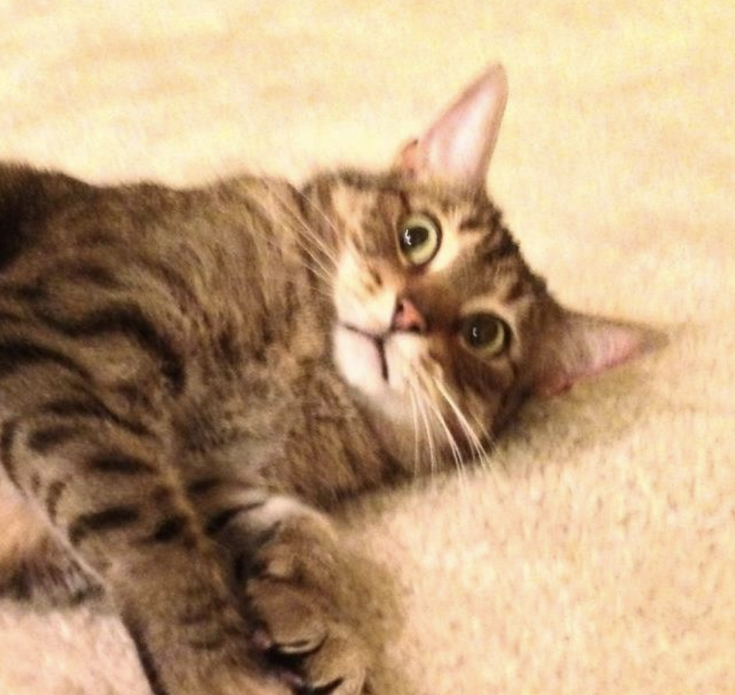
IDCat Serverless Application
UserID: Erika
OpenWhisk
Container
Function Trigger
function1
Notes:
IDCat takes a user ID and an image of a cat.

Slide 29
IDCat Serverless Application
UserID: Erika
OpenWhisk
Cat Model Database
Container
“Give me the ML model!”
Function Trigger
function1
“Here it is”
Notes:
The function will first fetch a machine learning model from an external database.

Slide 30
IDCat Serverless Application
UserID: Erika
OpenWhisk
Cat Model Database
Container
“Give me the ML model!”
Function Trigger
function1
does work!
“Here it is”
Notes:
The function will then do some work using the image and the model.

Slide 31
IDCat Serverless Application
UserID: Erika
OpenWhisk
Cat Model Database
Container
“Give me the ML model!”
Function Trigger
function1
“Here it is”
Store “Erika’s Cat, Brown Tabby”
Cat Database
“Saved!"
Notes:
The function will then take it’s result and write it to the external database.

Slide 32
IDCat Serverless Application
UserID: Erika
OpenWhisk
Cat Model Database
Container
“Give me the ML model!”
Function Trigger
function1
“Here it is”
Result: “Success!”
Store “Erika’s Cat, Brown Tabby”
Cat Database
“Saved!"
Notes:
If all of these operations finish without error, the function indicates that it executed successfully.

Slide 33
Improve Efficiency?
UserID: Erika
OpenWhisk
Cat Model Database
Container
“Give me the ML model!”
Function Trigger
function1
“Here it is”
Result: “Success!”
Store “Erika’s Cat, Brown Tabby”
Cat Database
“Saved!"
Notes:
Our journey begins when we start to ask: how can we improve efficiency in this scenario

Slide 34
Improve Efficiency?
UserID: Erika
OpenWhisk
Cat Model Database
Container
“Give me the ML model!”
Function Trigger
function1
“Here it is”
Result: “Success!”
Store “Erika’s Cat, Brown Tabby”
Cat Database
“Saved!"
Notes:
Throughout this talk I’ll focus on network connections. We want to avoid the instantiation and tear down of ephemeral connections as much as possible.

Slide 35
IDCat Microservice
Long-lived connection or connection pool
UserID: Erika
Microservice
Cat Model Database
“Give me the ML model!”
Request
Request
Handler
“Here it is”
Result: “Success!”
Store “Erika’s Cat, Brown Tabby”
…
Cat Database
Request
Handler
“Saved!"
Notes:
If IDCat were instead a microservice, there are well-known techniques for avoiding these overheads. As you can see here, each IDCat request is handled by a request handler. Each request handler uses a long-lived connection or connection pool to access the external entities.
This avoids latencies during connection creations, such as handshakes, and also avoids the operating system churn associated with creating and destroying networking connections.

Slide 36
Runtime Reuse in Serverless
Persistent connection or connection pool
OpenWhisk
Cat Model Database
/init (code, extras)
Container
Cat Database
Notes:
I’ll pivot back to a serverless infrastructure. Currently, it’s best practice in industry to use something we term “runtime reuse” to get a similar effect of the long-lived connection or the connection pool we just looked at in the microservice architecture.
In runtime reuse, a developer can define what we term “runtime scoped” variables when a container is initialized. In this case, IDCat would use a two connections or connection pools as runtime scoped variables.

Slide 37
Runtime Reuse in Serverless
OpenWhisk
Cat Model Database
Function Trigger
Container
function1
Cat Database
Notes:
Once the container is initialized, as IDCat requests arrive, the container can service one at a time. However, each one of those functions can access the runtime-scoped connection or connection pool. You can see this happening in the next two invocations

Slide 38
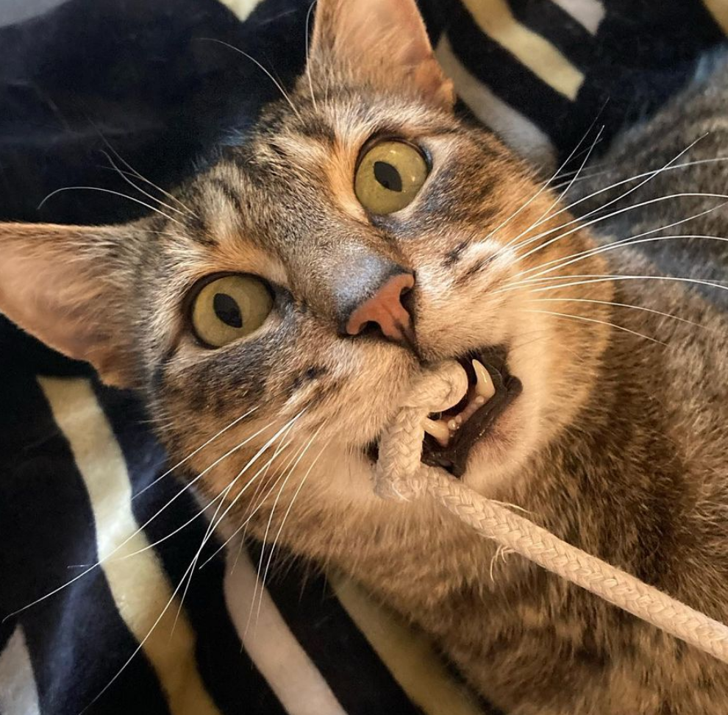
Runtime Reuse in Serverless
OpenWhisk
Cat Model Database
Container
Function Trigger
function1
Cat Database

Slide 39
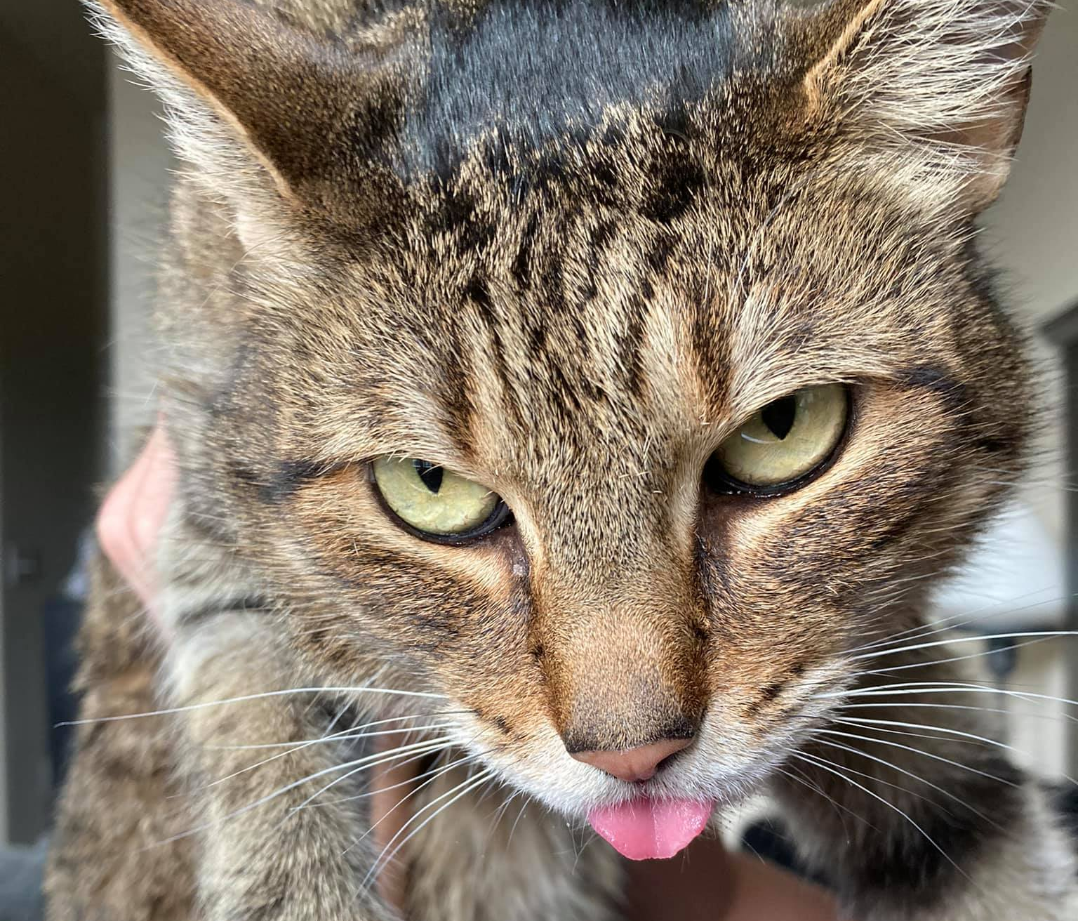
Runtime Reuse in Serverless
OpenWhisk
Cat Model Database
Container
Cat Database
Function Trigger
function1
Notes:
The benefit of this is that the connections are reused.

Slide 40
Runtime Reuse is Spatial
OpenWhisk
Cat Model Database
Container
Cat Database
Function Trigger
function1
Notes:
The benefit of this is that the connections are reused.

Slide 41
Runtime Reuse is Temporal
OpenWhisk
Cat Model Database
Container
Cat Database
Function Trigger
function1
Notes:
The benefit of this is that the connections are reused.

Slide 42
Runtime Reuse in Serverless – Room for Improvement?
OpenWhisk
Cat Model Database
Container
Cat Database
Function Trigger
function1
Notes:
Our research journey continues when we ask, where is there room for improvement beyond runtime reuse?

Slide 43
Outline
Background
Freshen Design
Evaluation
Discussion
Notes:
And this brings us to our freshen design.

Slide 44
Overview
We propose a new serverless runtime primitive, freshen, as a mechanism to enable proactive serverless function resource management.
Goals:
Build mechanism for dynamic resource management into serverless lifecycle
Reduce function latency
Dynamically manage state without cluttering function code
Notes:
Depending on implementation, this could also reduce code clutter by separating function logic from dynamic resource management. But before I get too far into the details, let’s look at a graphical representation of freshen.

Slide 45
Freshen Design
Time=0
/init
init
/run
function1
Notes:
This is the existing container lifecycle in OpenWhisk. There are two runtime hooks, as wel call them, to define actions within the container
The first is init, which loads functions code into a container and prepares the environment to later run that function. Run actually causes the function to execute.

Slide 46
Freshen Design
Time=0
/init
init
/freshen
freshen
/run
function1
Notes:
We propose freshen as a third runtime hook. Ideally, freshen would be invoked based on a prediction window

Slide 47
Freshen Design
Time=0
/init
init
/freshen
freshen
Prediction window
/run
function1
Notes:
This prediction window would allow freshen to run before the function executes.

Slide 48
Freshen Design
Time=0
/init
init
Policy Options:
Prediction
Concurrency
Forced blocking
/freshen
freshen
Prediction window
/run
function1
Notes:
When adding the freshen runtime hook, there are a couple of different policy options. We can try prediction, or not. If the prediction window is too small or we opt out of prediction, freshen could run concurrently with the function or force the function to block until freshen has finished executing.

Slide 49


Serverless Resource Management Overview
Time=0
/init
init
 | Reuse | Dynamic State | Proactive
Init Phase
Function Code
Runtime Reuse
Freshen
/run
function1
/run
function1
Notes:
I’ve covered several different ways to manage resources in a serverless environment, so I’ll give a high-level summary of the techniques we’ve covered so far.
Using only runtime scoped variables during the init phase, we can create reuse those variables or results. However, init only runs once during a container’s lifetime so this does not support dynamic state. Similarly, since it doesn’t support dynamic state we also say it’s not proactive; if a value is out of date or a connection stale, the function won’t know until it tries to use it.

Slide 50
Serverless Resource Management Overview
Time=0
/init
init
 | Reuse | Dynamic State | Proactive
Init Phase
Function Code
Runtime Reuse
Freshen
/run
function1
/run
function1
Notes:
If we only use function code, the variables defined here cannot be reused. However, if you do some task every time the function runs it is guaranteed to be fresh. An example of this would be that we know we’ll have the most up-to-date ML model in IDCat if we fetch it each time we run a function. However, it’s not proactive – the function incurs latency during it’s execution time to complete the dynamic resource management tasks.

Slide 51
Serverless Resource Management Overview
Time=0
/init
Init
 | Reuse | Dynamic State | Proactive
Init Phase
Function Code
Runtime Reuse
Freshen
/run
Function1
/run
Function1
Notes:
Runtime reuse is implemented through combing the runtime scoped variables defined during init with dynamic state maintenance in the freshen code. However, this is not a proactive solution.

Slide 52
Serverless Resource Management Overview
Time=0
/init
Init
 | Reuse | Dynamic State | Proactive
Init Phase
Function Code
Runtime Reuse
Freshen
/freshen
freshen
/run
Function1
/freshen
freshen
/run
Function1
Notes:
With freshen we want to continue with reuse of runtime-scoped variables but move the dynamic state maintenance from the function code and into our new freshen primitive.

Slide 53
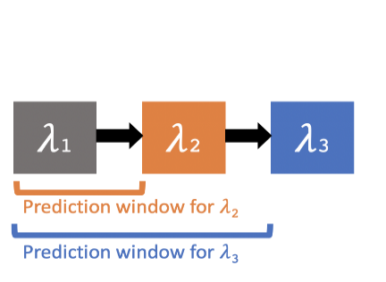
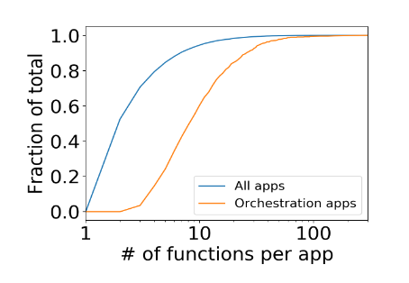
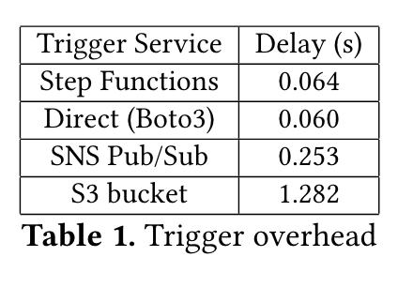
Serverless Function Prediction
Some cases are easier to predict, e.g. chained functions
Many applications consist of multiple functions
Prediction useful for many reasons (scheduling, resource utilization, coldstart avoidance, etc.)
May be infrastructure overheads
Notes:
Serverless function prediction is use fro…
I’ll make a few observations about prediction here.

Slide 54
Serverless Function Prediction
Some cases are easier to predict, e.g., chained functions
Prediction useful for many reasons (scheduling, resource utilization, coldstart avoidance, etc.)
Notes:
First, we observe it may be easier to predict when functions within a function chain run. Even fi they aren’t directly chained, functions that are part of the same application may have causal patterns that could lead to accurate prediction.

Slide 55
Serverless Function Prediction
Some cases are easier to predict, e.g., chained functions
Many applications consist of multiple functions
Prediction useful for many reasons (scheduling, resource utilization, coldstart avoidance, etc.)
Notes:
Second, we also observe that many applications that are composed of multiple functions include chained functions.

Slide 56
Serverless Function Prediction
Some cases are easier to predict, e.g., chained functions
Many applications consist of multiple functions
Prediction useful for many reasons (scheduling, resource utilization, coldstart avoidance, etc.)
May be infrastructure overheads
Notes:
The graph here shows some overheads of ways of invoking functions. Since there exist overheads in serverless infrastructure, it’s possible we could use those overhead windows to lengthen our prediction windows.

Slide 57
What Can Freshen Do?
Notes:
If we can predict functions in order to run freshen, we can begin asking: what can freshen do?

Slide 58
What Can Freshen Do?
UserID: Erika
OpenWhisk
Cat Model Database
“Give me the ML model!”
Function Trigger
Function1
“Here it is”
Result: “Success!”
Store “Erika’s Cat, Brown Tabby”
Cat Database
“Saved!"
Notes:
Let’s return to our initial IDCat example. There are two freshen actions we’ll want to do for sure, corresponding to the two network connections.

Slide 59
What Can Freshen Do?
UserID: Erika
OpenWhisk
Cat Model Database
“Give me the ML model!”
PREFETCH
Function Trigger
Function1
“Here it is”
Result: “Success!”
Store “Erika’s Cat, Brown Tabby”
Cat Database
“Saved!"
Notes:
The first thing we’ll want to do is prefetch our machine learning model.

Slide 60
What Can Freshen Do?
UserID: Erika
OpenWhisk
Cat Model Database
“Give me the ML model!”
Function Trigger
Function1
“Here it is”
Result: “Success!”
Store “Erika’s Cat, Brown Tabby”
Cat Database
“Saved!"
WARM CONNECTION
Notes:
The second thing we’ll want to do is to ‘warm’ the connection to this cat database. I use the term ‘warm’ to mean that the connection is both established and ready to send/receive traffic in other ways, such as an appropriate congestion window.

Slide 61
What Can Freshen Do?
UserID: Erika
OpenWhisk
Cat Model Database
“Give me the ML model!”
Function Trigger
Function1
“Here it is”
Result: “Success!”
Store “Erika’s Cat, Brown Tabby”
Cat Database
“Saved!"
MORE?
Notes:
We believe there is more things freshen can do, which I’ll touch on during the discussion section.

Slide 62
Outline
Background
Freshen Design
Evaluation
Discussion
Notes:
But first, let’s go over some preliminary data on potential freshen actions.

Slide 63
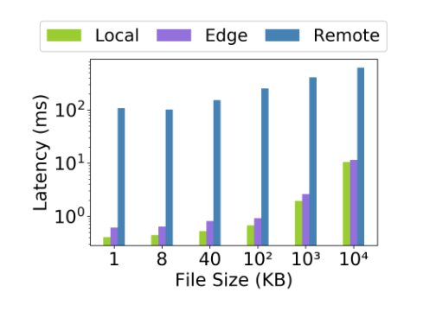
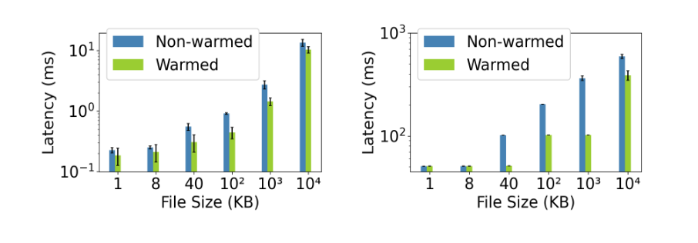
Freshen Motivation
PREFETCH
WARM CONNECTION
Reduces latency to access data

Slide 64
Freshen Motivation
PREFETCH
WARM CONNECTION
Warmed TCP connections send traffic more efficiently

Slide 65
Outline
Background
Freshen Design
Evaluation
Discussion

Slide 66
Discussion
Connection state manipulation
Function prediction
Scalability
Generality
Who is responsible for freshen?
Developer
Libraries
Inference
Other freshen actions
Memory allocation?
Caches?
Things we have not yet thought of?
How to access connection state?
Beyond TCP?

Slide 67
Discussion
Connection state manipulation
How to access?
Function prediction
Scalability
Generality
Who is responsible for freshen?
Developer
Libraries
Inference
Other freshen actions
Memory allocation?
Beyond TCP
Caches?
Things we have not yet thought of?

Slide 68
Serverless App
ML App
Application
4
1
Extensions to IRON
Programming Interface
Freshen
State Lifecycle
Serverless Framework
Framework
Container Runtime
Runtime
2
Escra
Auto-scaling
3
Linux
DiNOS
Operating System
LD-NR
Dynamic Replication
Hardware
CPU
CPU
NPU
Mem
Interconnect
Mem
Agenda: Freshen

Slide 69
Serverless App
ML App
Application
4
1
Extensions to IRON
Programming Interface
Freshen
State Lifecycle
Serverless Framework
Framework
Container Runtime
Runtime
2
Escra
Auto-scaling
3
Linux
DiNOS
Operating System
LD-NR
Dynamic Replication
Hardware
CPU
CPU
NPU
Mem
Interconnect
Mem
Agenda: Escra

Slide 70
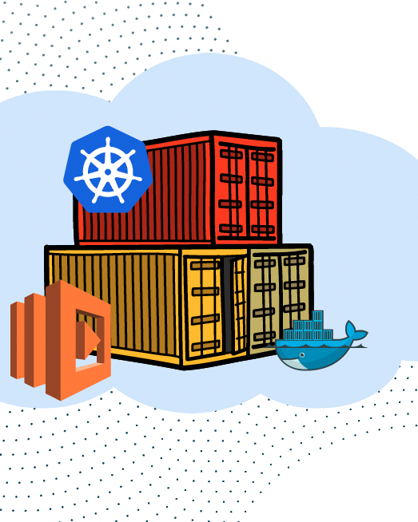
Containerized Infrastructure
Light-weight
Rich orchestration systems
Developer workflow integration
Resource isolation

Slide 71
Developers must make tradeoffs!
Prioritize Performance

Slide 72
Developers must make tradeoffs!
Prioritize Performance
Performance

Slide 73
Developers must make tradeoffs!
Prioritize Performance
Performance
Efficiency

Slide 74
Developers must make tradeoffs!
Prioritize Performance
Overallocate resources
Performance
Efficiency

Slide 75
Developers must make tradeoffs!
Prioritize Performance
Prioritize Resource Efficiency
Overallocate resources
Performance
Efficiency

Slide 76
Developers must make tradeoffs!
Prioritize Performance
Prioritize Resource Efficiency
Overallocate resources
Performance
Efficiency
Efficiency

Slide 77
Developers must make tradeoffs!
Prioritize Performance
Prioritize Resource Efficiency
Overallocate resources
Performance
Efficiency
Performance
Efficiency

Slide 78
Developers must make tradeoffs!
Prioritize Resource Efficiency
Underallocate resources
CPU Throttles
Out of Memory Events (OOMS)
Performance
Efficiency

Slide 79
Setting Container Limits is Difficult
Requires representative workload
Resource needs vary over time
Tools aggregate usage of coarse-grained timescales

Slide 80
Setting Container Limits is Difficult
Requires representative workload
Resource needs vary over time
Tools aggregate usage of coarse-grained timescales
Result: Overprovisioned containers

Slide 81
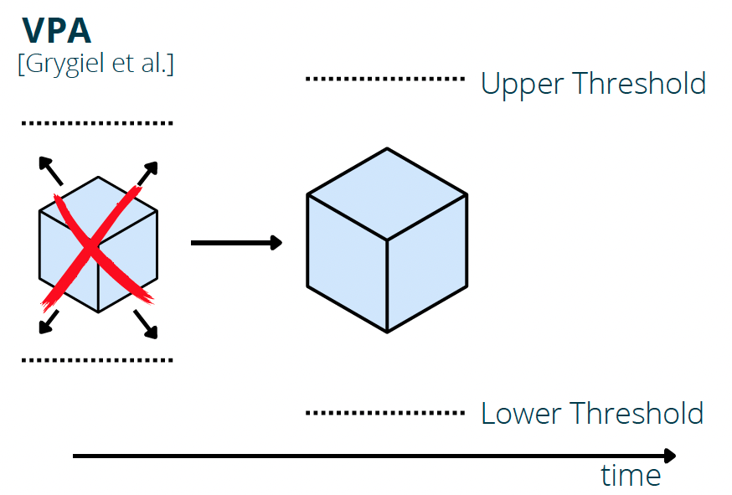
Recent Work: Threshold Scaling
Container Restart to scale
Scale once per minute
High slack

Slide 82
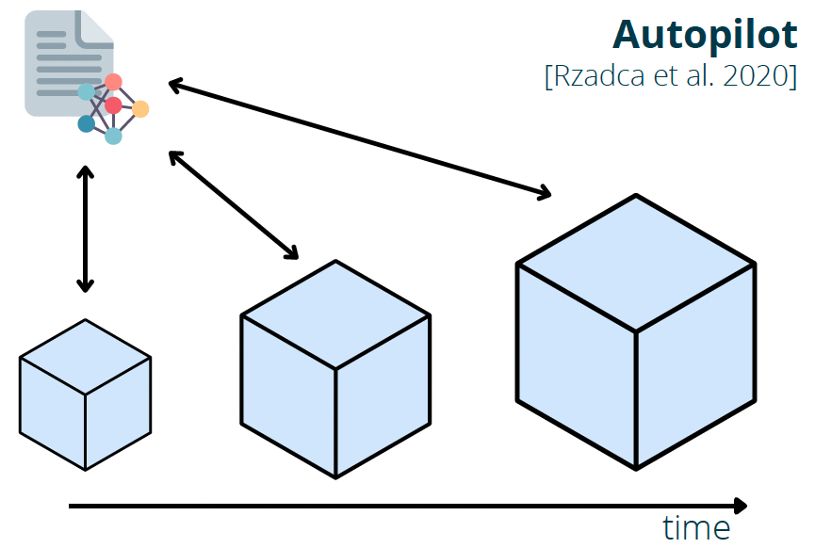
Recent Work: ML-Based Scaling
Cannot respond to quick changes in workload
Must allocate max prediction over 5-min interval
Unable to correct inaccurate predictions
Not suitable for short-lived containers (e.g., serverless)

Slide 83
Key insight: If we can make resource allocation fine-grained, we don’t need to predict; we can react to workload changes.

Slide 84
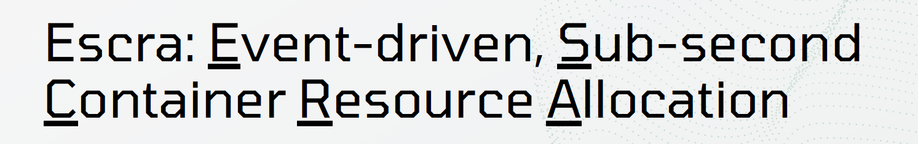
Distributed resource allocation
Sub-second interval scaling within and across hosts
OOM prevention
Immediate CPU throttle response
No performance penalty

Slide 85
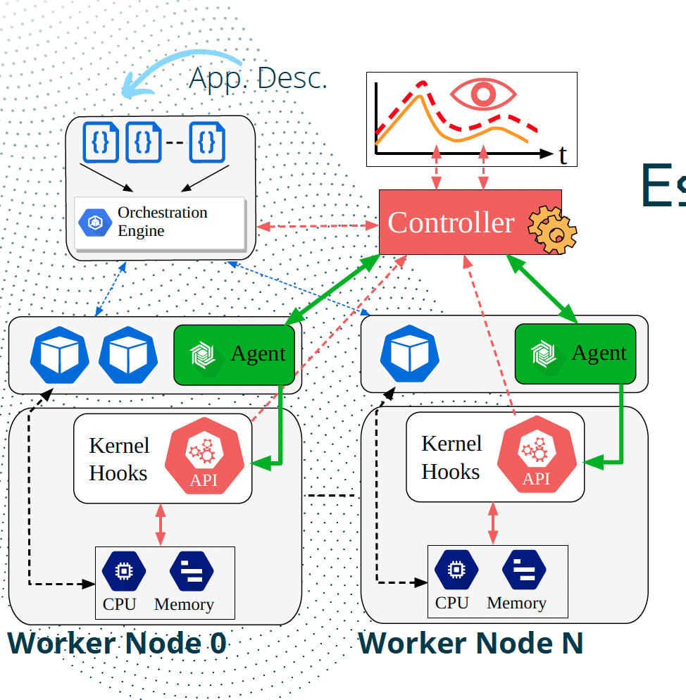

Slide 86
Kernel hooks

Slide 87
Controller

Slide 88
Resource Allocator

Slide 89
Agent

Slide 90
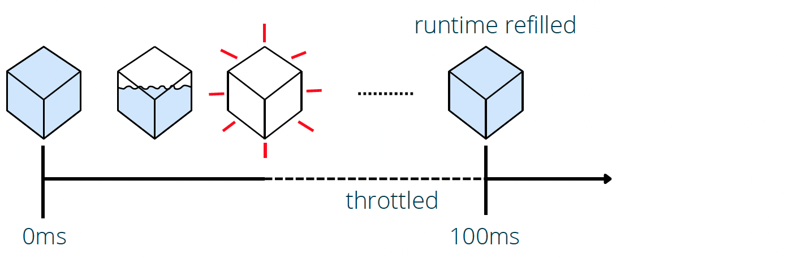
CPU Telemetry and Scaling

Slide 91
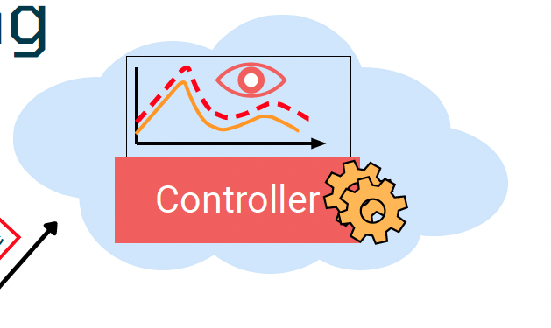
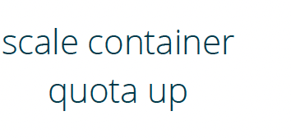
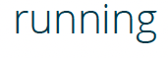
CPU Telemetry and Scaling

Slide 92
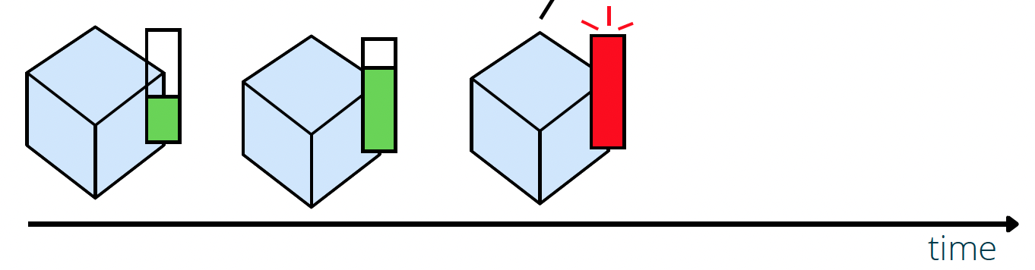
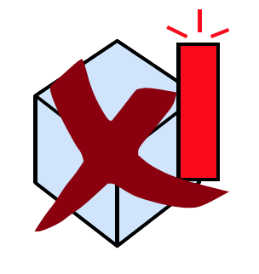
Event-Based Memory Scaling

Slide 93
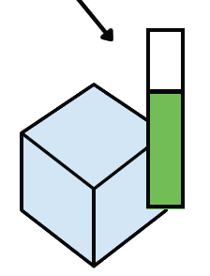
Event-Based Memory Scaling

Slide 94
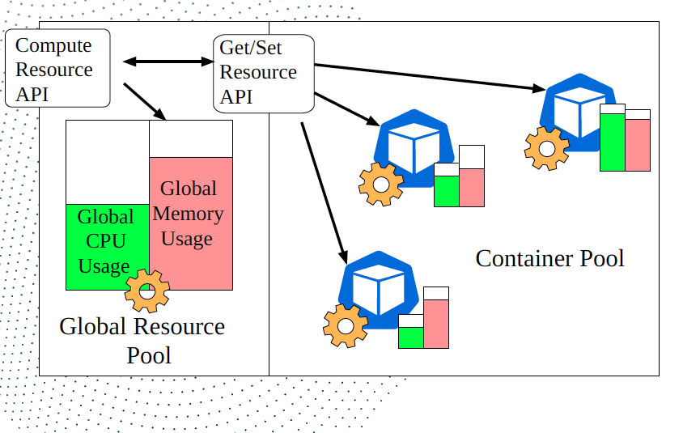
What about aggregate limits?
Distributed Container

Slide 95
Evaluation
Absolute Slack = Container Limit – Container Usage
Application Throughput: Successful requests / second
Application 99.9%ile Latency: End-to-End 99.9%ile latency

Slide 96
Evaluation
Applications
Workloads
TrainTicket
TeaStore
HipsterShop
MediaMicroservice
Alibaba
Burst
Exponential
Fixed

Slide 97
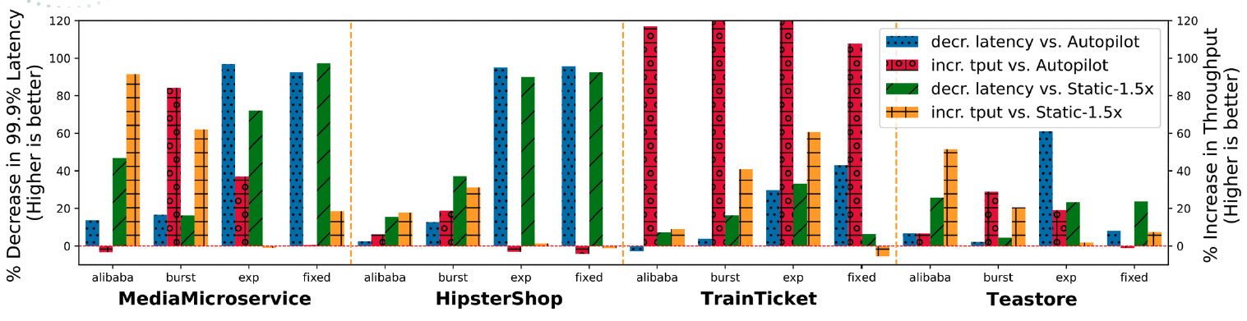

Slide 99
Evaluation
Aggregate Limits = Sum(Container Limit) – Sum(Container Usage)
Application Latency: End-to-End latency per request or job

Slide 100
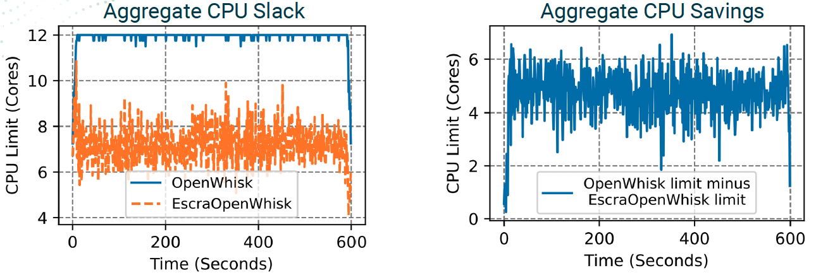
Image Process: CPU

Slide 101
Escra + OpenWhisk avg(vCPU limit): 7 vCPU
OpenWhisk avg(vCPU limit): 12 vCPU
Image Process: CPU

Slide 102
Serverless App
ML App
Application
4
1
Extensions to IRON
Programming Interface
Freshen
State Lifecycle
Serverless Framework
Framework
Container Runtime
Runtime
2
Escra
Auto-scaling
3
Linux
DiNOS
Operating System
LD-NR
Dynamic Replication
Hardware
CPU
CPU
NPU
Mem
Interconnect
Mem
Agenda: Escra

Slide 103
Serverless App
ML App
Application
4
1
Extensions to IRON
Programming Interface
Freshen
State Lifecycle
Serverless Framework
Framework
Container Runtime
Runtime
2
Escra
Auto-scaling
3
Linux
DiNOS
Operating System
LD-NR
Dynamic Replication
Hardware
CPU
CPU
NPU
Mem
Interconnect
Mem
Agenda: LD-NR/DiNOS

Slide 104
Overview
Introduction to NR
DiNOS
Motivation for Dynamic Replication
LD-NR
Background on NUMA

Slide 105
Overview
Introduction to NR
DiNOS
Motivation for Dynamic Replication
LD-NR
Background on NUMA

Slide 106
NUMA Systems
NUMA Domain
NUMA Domain
Compute
Compute
Slow Access
Fast Access
Fast Access
Memory Region
Memory Region

Slide 107
NUMA Systems
Host
NUMA Domain
NUMA Domain
Compute
Compute
Slow Access
Fast Access
Fast Access
Memory Region
Memory Region

Slide 108
Extended NUMA Systems
Rackscale?
Host
Host
NUMA Domain
NUMA Domain
Compute
Compute
Slow Access
Fast Access
Fast Access
Memory Region
Interconnect
Memory Region

Slide 109
Spatial and Temporal
Where is data, where is compute? (changes over time)
NUMA Domain
NUMA Domain
Compute
Compute
Slow Access
Fast Access
Fast Access
Memory Region
Memory Region

Slide 110
Overview
Introduction to NR
DiNOS
Motivation for Dynamic Replication
LD-NR
Background on NUMA

Slide 111
Node Replication
Algorithm for performant management of data in NUMA systems via replication
Black-box library for sequential data structures (ASPLOS’17)
Used in Node replicated Operating System (NrOS) for per-process pages tables (OSDI’12)

Slide 112
Node Replication
Algorithm for performant management of data in NUMA systems via replication
Black-box library for sequential data structures (ASPLOS’17)
Used in Node replicated Operating System (NrOS) for per-process pages tables (OSDI’12)

Slide 113
Node Replication
Algorithm for performant management of data in NUMA systems via replication
Black-box library for sequential data structures (ASPLOS’17)
Used in Node replicated Operating System (NrOS) for per-process pages tables (OSDI’12)

Slide 114


NUMA 0
AnyMem
Replica₀
LocalTailPtr
SharedLog
LogTailPtr
Hashmap
OpBuffer
get()... put()
op_{n}
App Threads
…
op_{n+1}
…
NUMA R
Replica_{r}
op_{n+m}
LocalTailPtr
empty
Hashmap
empty
get()... put()
App Threads
Node Replication Overview

Slide 115
NUMA 0
AnyMem
Replica₀
LocalTailPtr
SharedLog
LogTailPtr
Hashmap
OpBuffer
get()... put()
op_{n}
App Threads
…
op_{n+1}
…
NUMA R
Replica_{r}
op_{n+m}
LocalTailPtr
empty
Hashmap
empty
get()... put()
App Threads
Node Replication Overview

Slide 116
NUMA 0
AnyMem
Replica₀
LocalTailPtr
SharedLog
LogTailPtr
Hashmap
OpBuffer
get()... put()
op_{n}
App Threads
…
op_{n+1}
…
NUMA R
Replica_{r}
op_{n+m}
LocalTailPtr
empty
Hashmap
empty
get()... put()
App Threads
Node Replication Overview

Slide 117


NUMA 0
AnyMem
Replica₀
LocalTailPtr
SharedLog
LogTailPtr
Hashmap
OpBuffer
get()... put()
op_{n}
App Threads
…
op_{n+1}
…
NUMA R
Replica_{r}
op_{n+m}
LocalTailPtr
empty
Hashmap
empty
get()... put()
App Threads
Node Replication Overview

Slide 118
Benefits of NR
Most threads only to access NUMA-local replica to fulfill operation
Optimized batching, fast read path, etc.
Shown scalable to many application threads

Slide 119
Benefits of NR
Most threads only to access NUMA-local replica to fulfill operation
Optimized batching, fast read path, etc.
Shown scalable to many application threads

Slide 120
Benefits of NR
Most threads only to access NUMA-local replica to fulfill operation
Optimized batching, fast read path, etc.
Shown provides scalability, to many application threads

Slide 121
Benefits of NR
Most threads only to access NUMA-local replica to fulfill operation
Optimized batching, fast read path, etc.
Shown provides scalability, to many application threads
But only supports static configuration, metrics assume one replica per NUMA domain

Slide 122
Overview
Introduction to NR
DiNOS
Motivation for Dynamic Replication
LD-NR
Background on NUMA

Slide 123
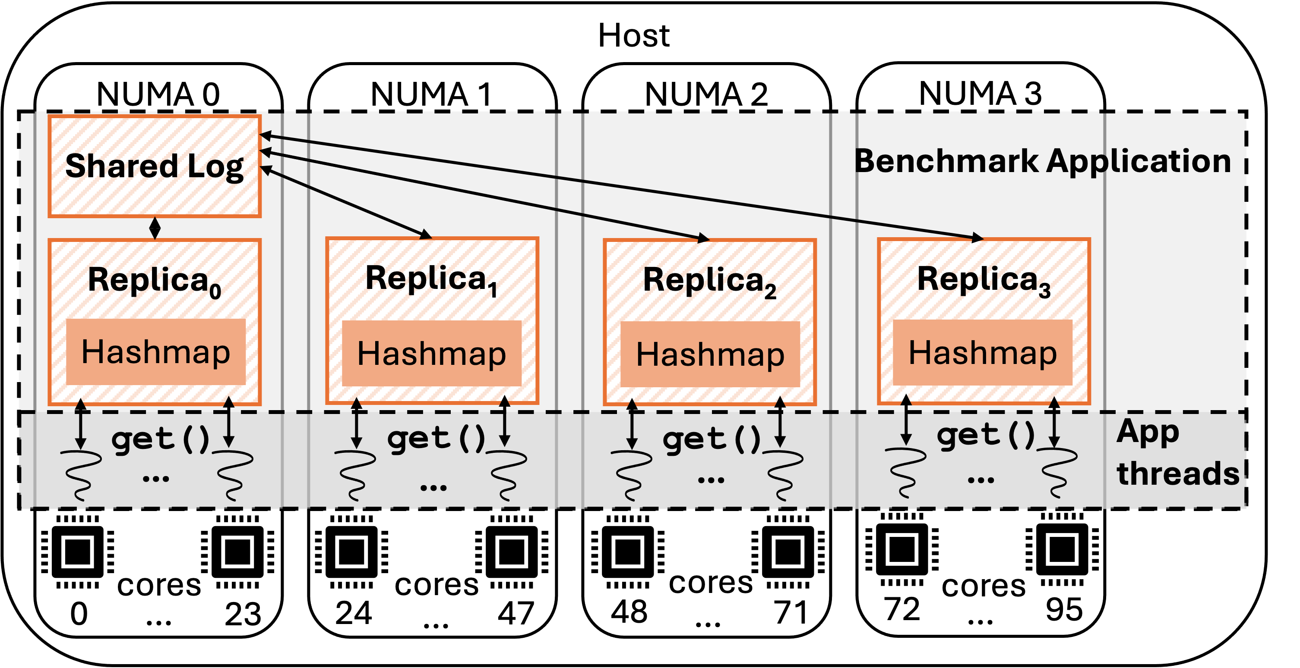
Environment of NR

Slide 124
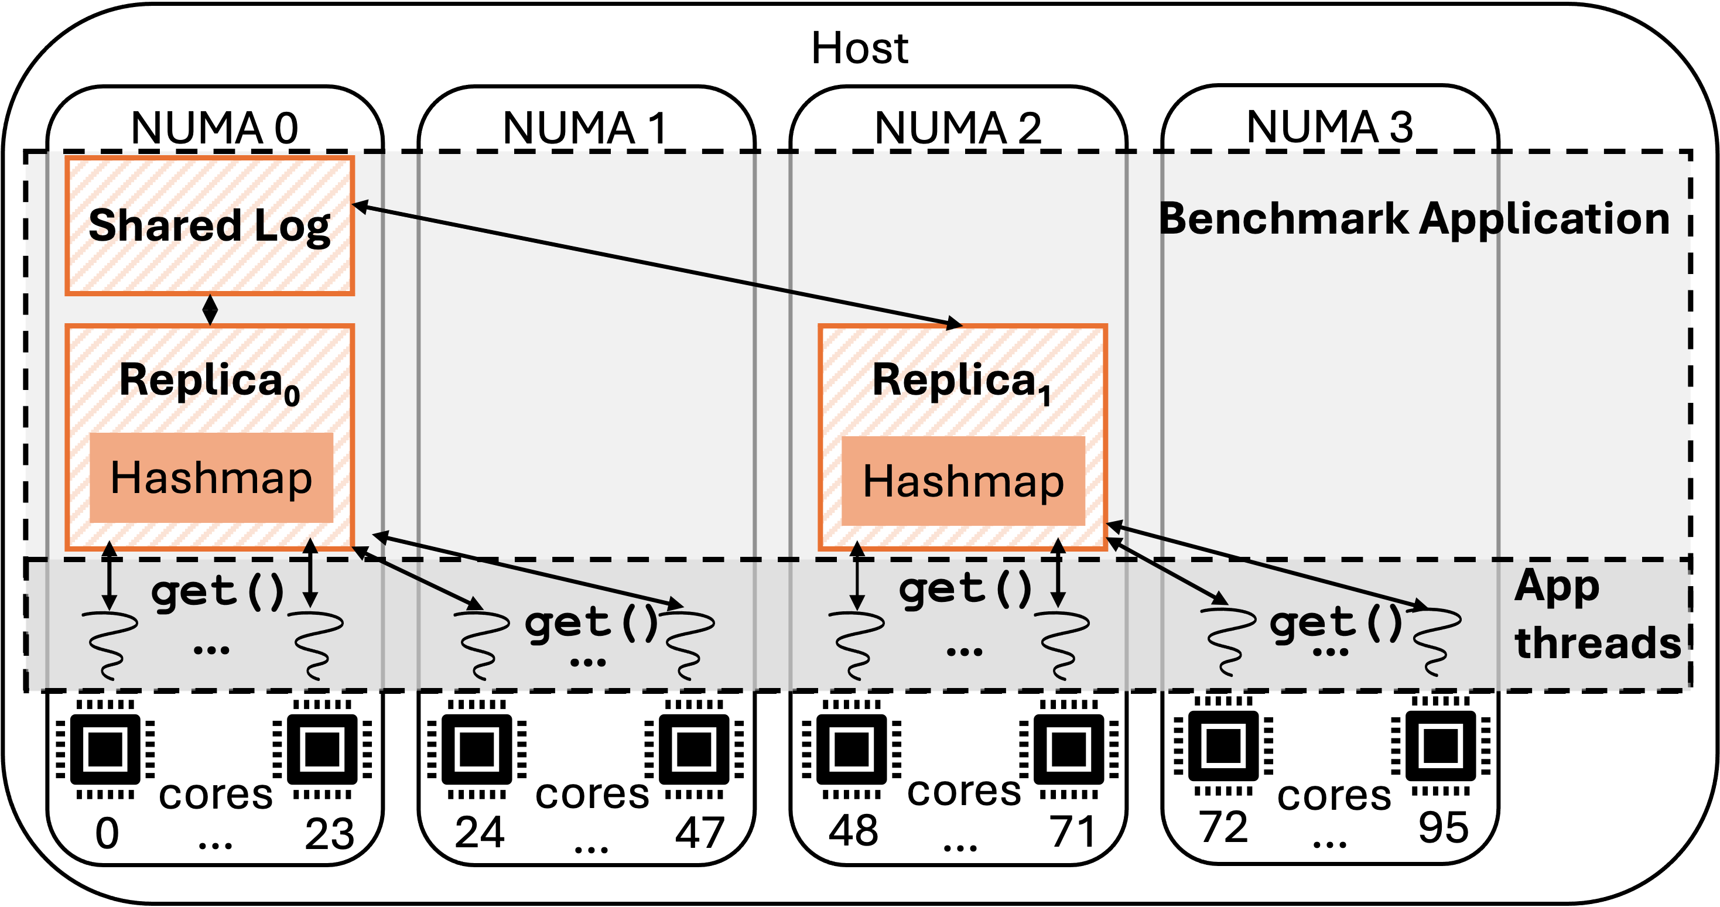

Slide 125
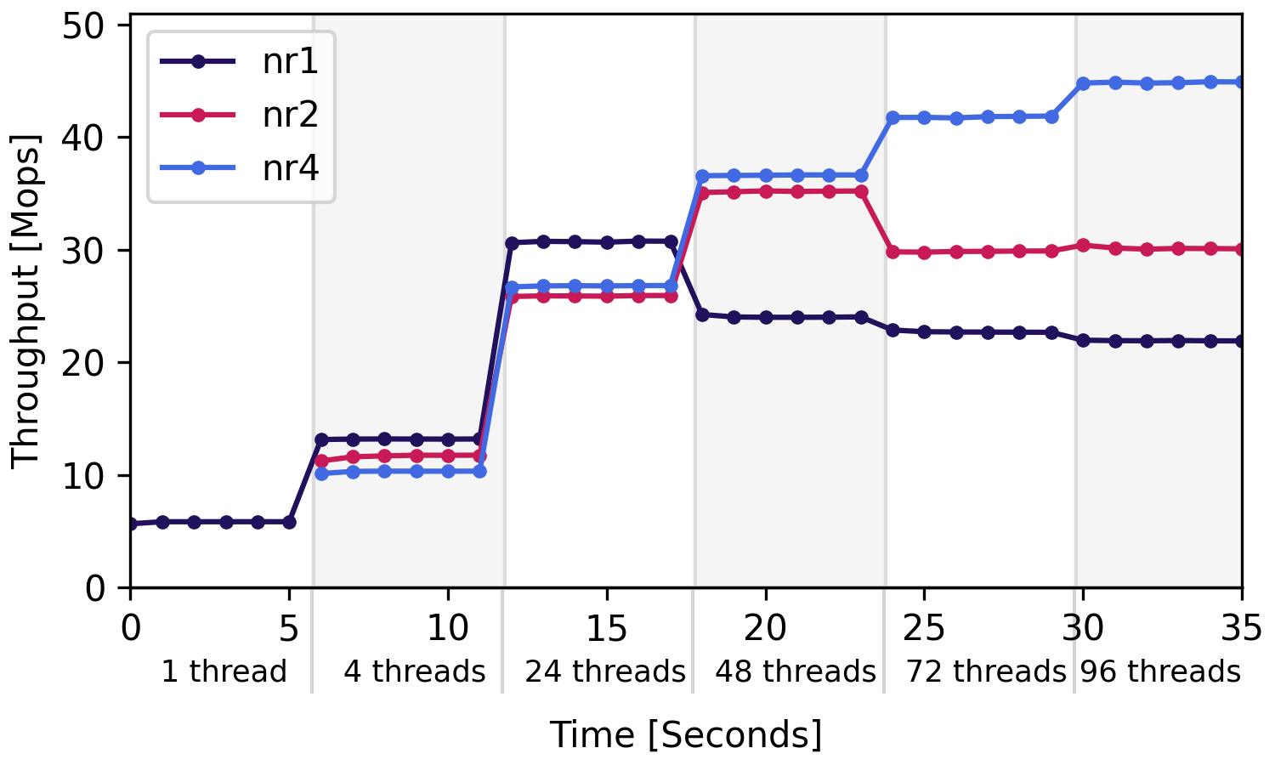

Slide 129
Problem 1: No static policy is uniformly best for an application with dynamic scaling.

Slide 131
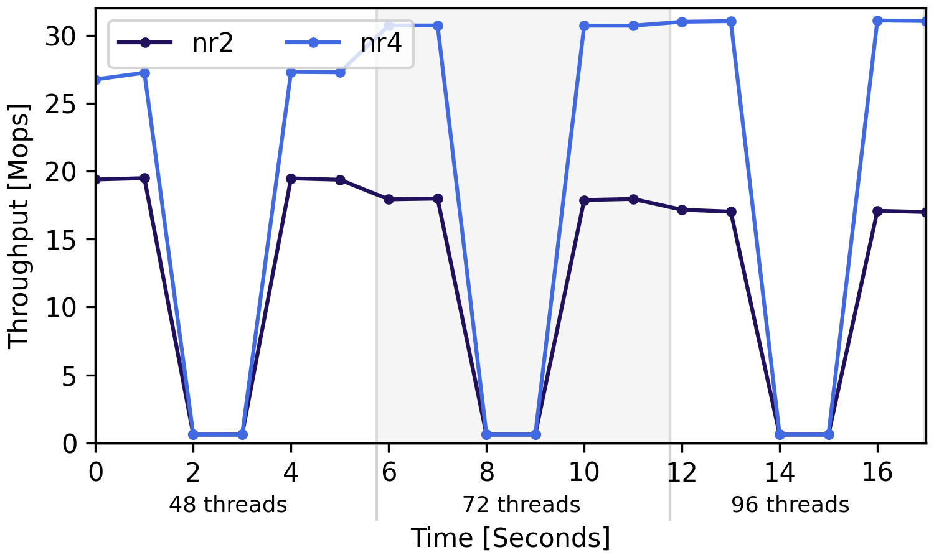

Slide 133
Problem 2: Too many replicas, too little work can lead to liveness problems.

Slide 135
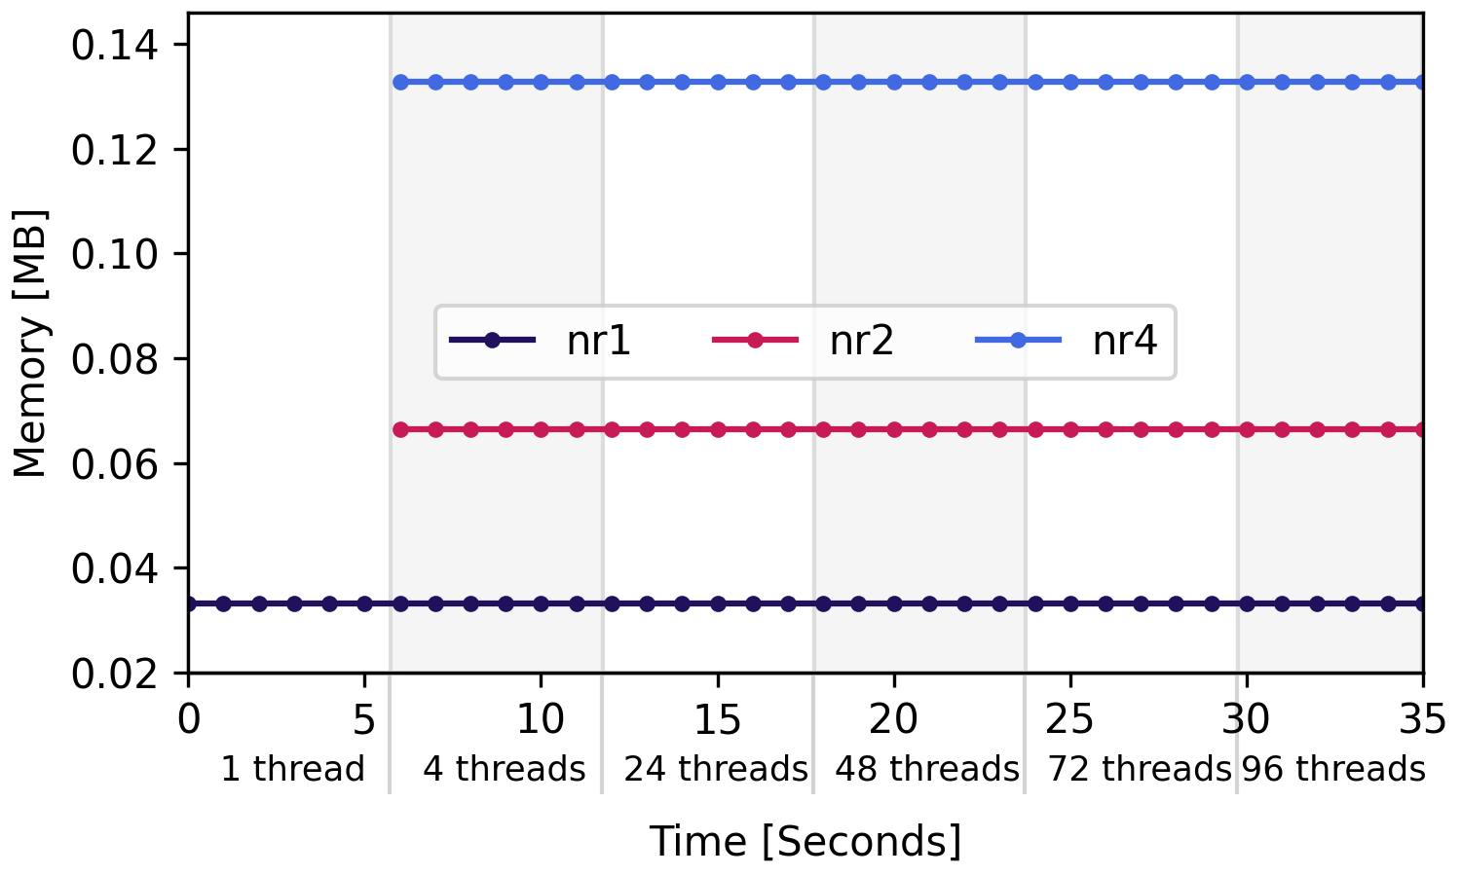
Performance
(Throughput)
Memory
Utilization

Slide 136
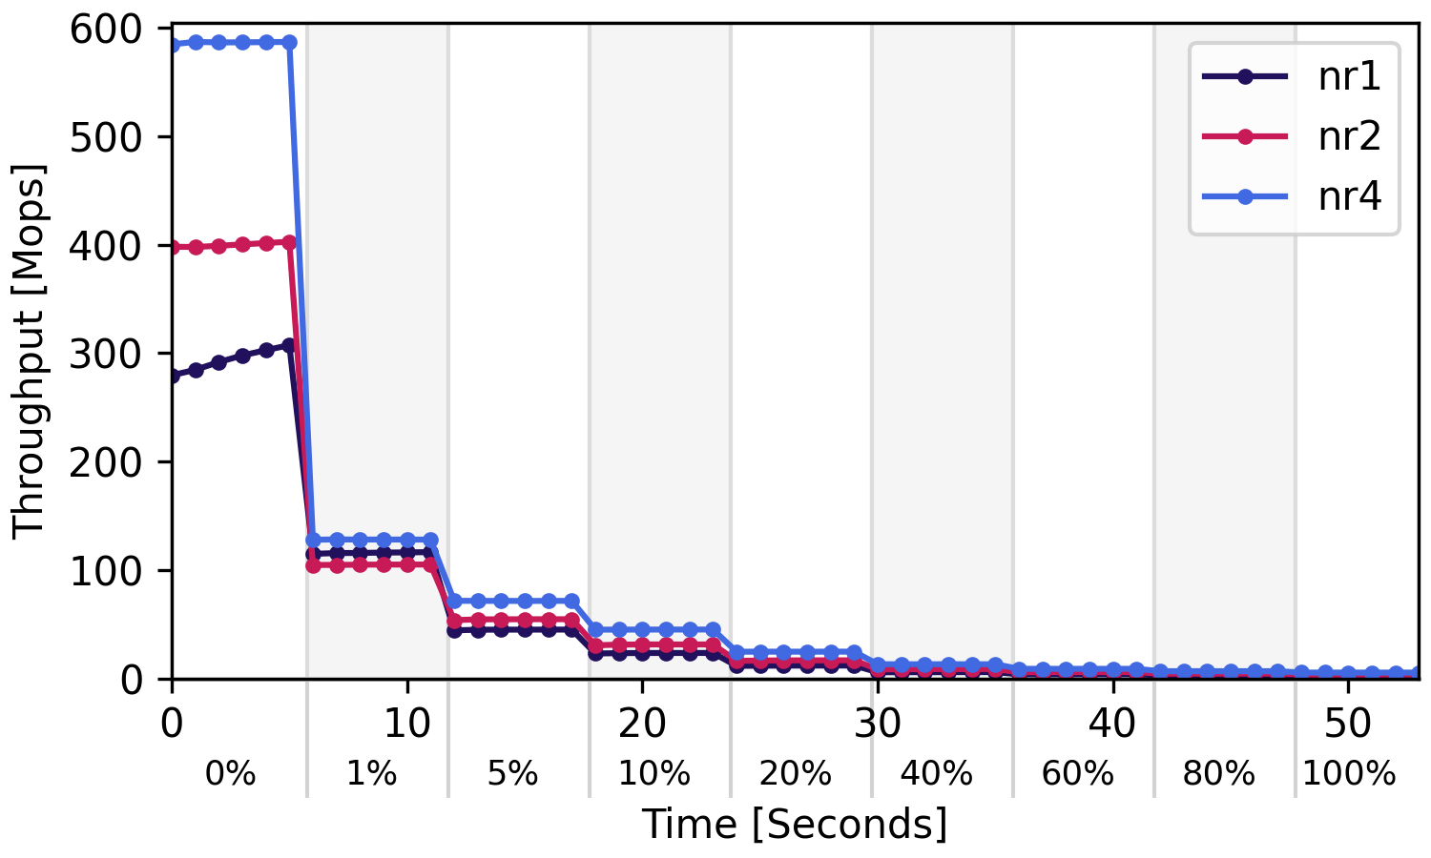

Slide 137
Problem 3: Static policy does not allow the performance/memory tradeoff to be dynamically navigated

Slide 138
Overview
Introduction to NR
DiNOS
Motivation for Dynamic Replication
LD-NR
Background on NUMA

Slide 139
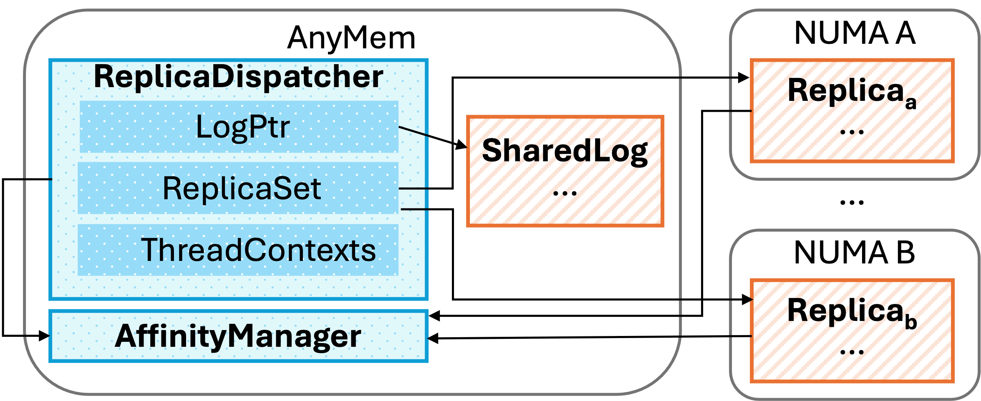
Live, Dynamic Node Replication

Slide 140
LD-NR
Add/remove replicas on demand
Route threads to local replicas if they exist
Combiner for remote replica, to ensure liveness

Slide 141
LD-NR
Add replica implemented through replica cloning technique
Affinity manager used to manage new replica resources
Add/remove replicas on demand
Route threads to local replicas if they exist
Combiner for remote replica, to ensure liveness

Slide 142
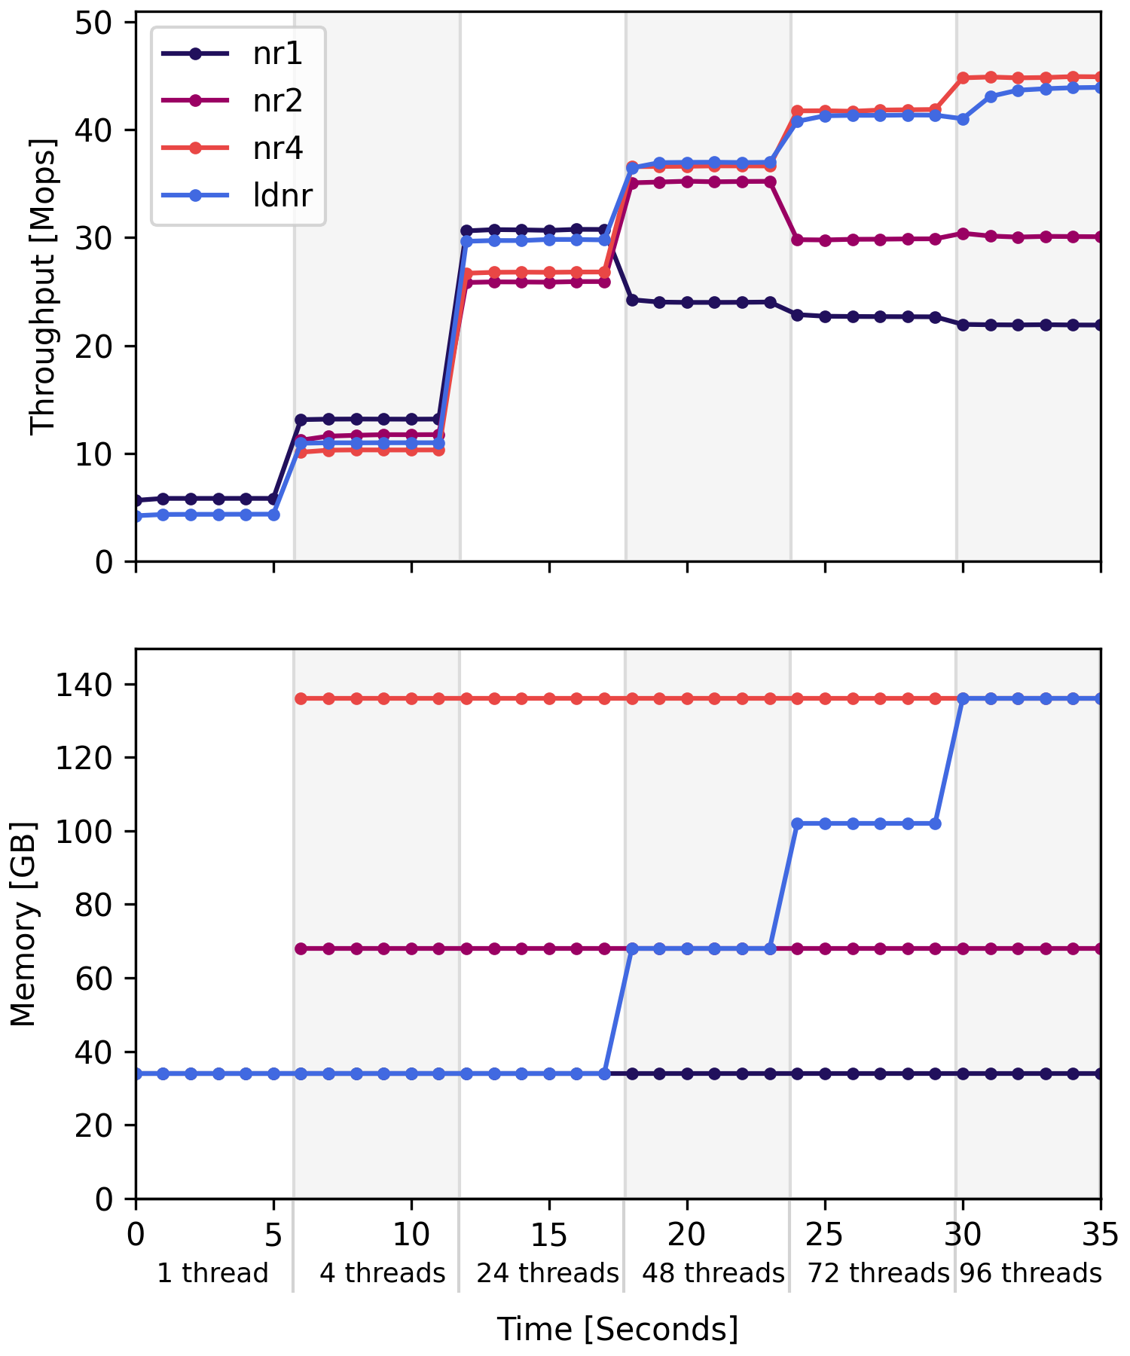
LD-NR
Add/remove replicas on demand
Route threads to local replicas if they exist
Combiner for remote replica, to ensure liveness

Slide 143
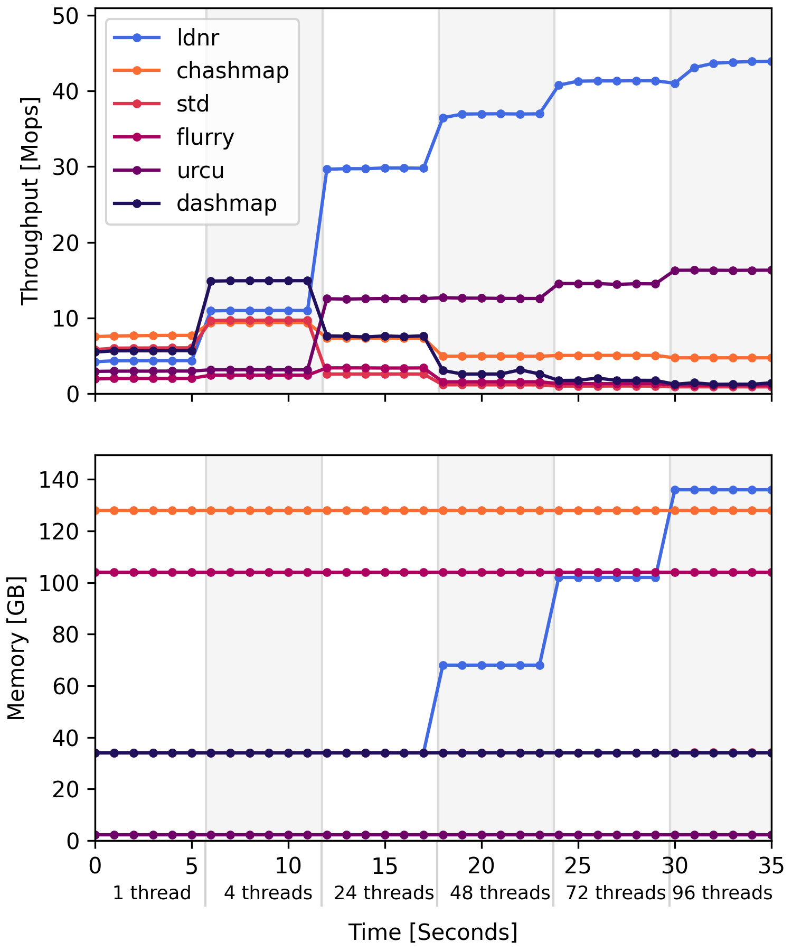
LD-NR
Add/remove replicas on demand
Route threads to local replicas if they exist
Combiner for remote replica, to ensure liveness

Slide 144
LD-NR
Add/remove replicas on demand
Route threads to local replicas if they exist
Combiner for remote replica, to ensure liveness
Dispatcher does thread routing
Affinity manager handles non-local case

Slide 145
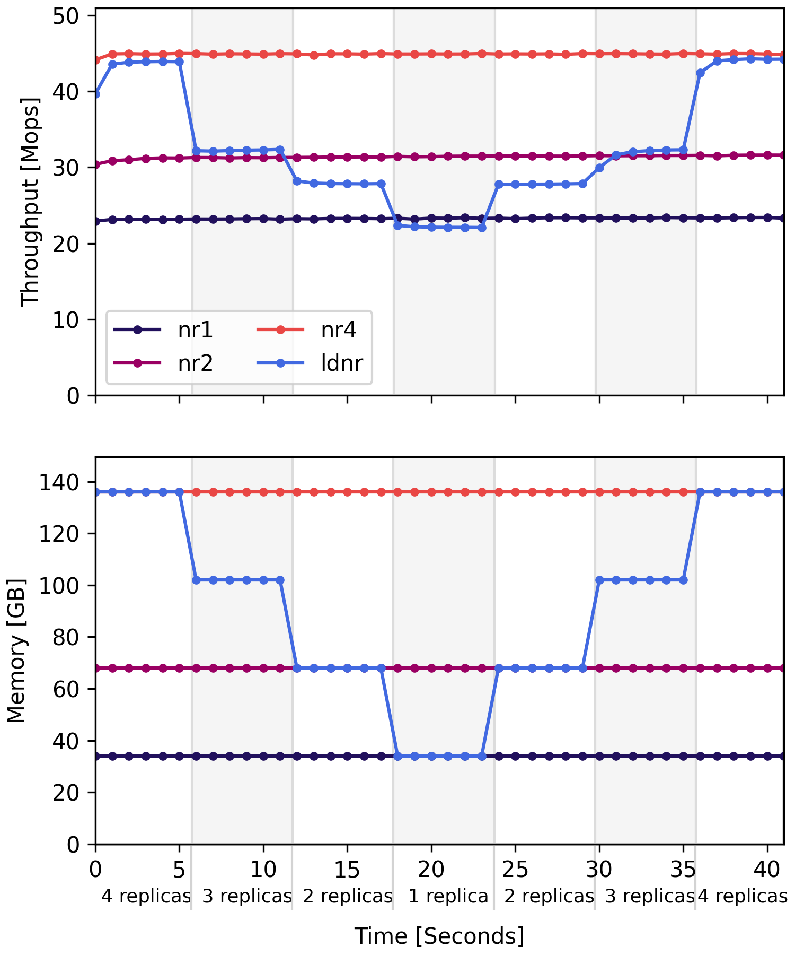
LD-NR
Add/remove replicas on demand
Route threads to local replicas if they exist
Combiner for remote replica, to ensure liveness

Slide 146
LD-NR
Add/remove replicas on demand
Route threads to local replicas if they exist
Combiner for remote replica, to ensure liveness
Affinity manager handles non-local case

Slide 147
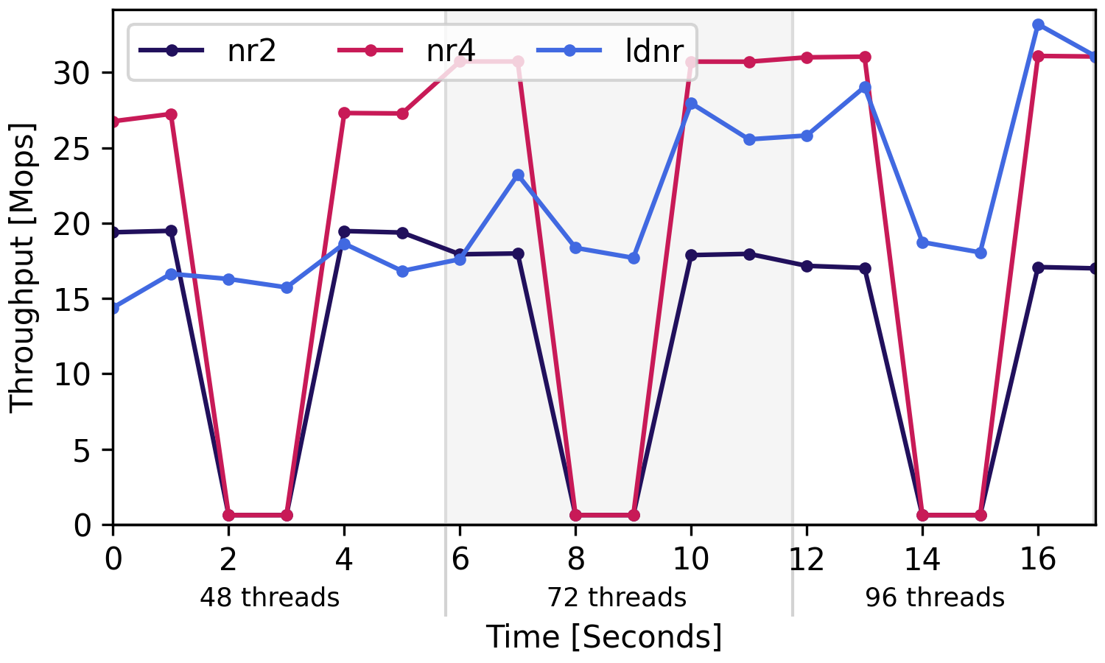
LD-NR
Add/remove replicas on demand
Route threads to local replicas if they exist
Combiner for remote replica, to ensure liveness

Slide 148
Overview
Introduction to NR
DiNOS
Motivation for Dynamic Replication
LD-NR
Background on NUMA

Slide 149
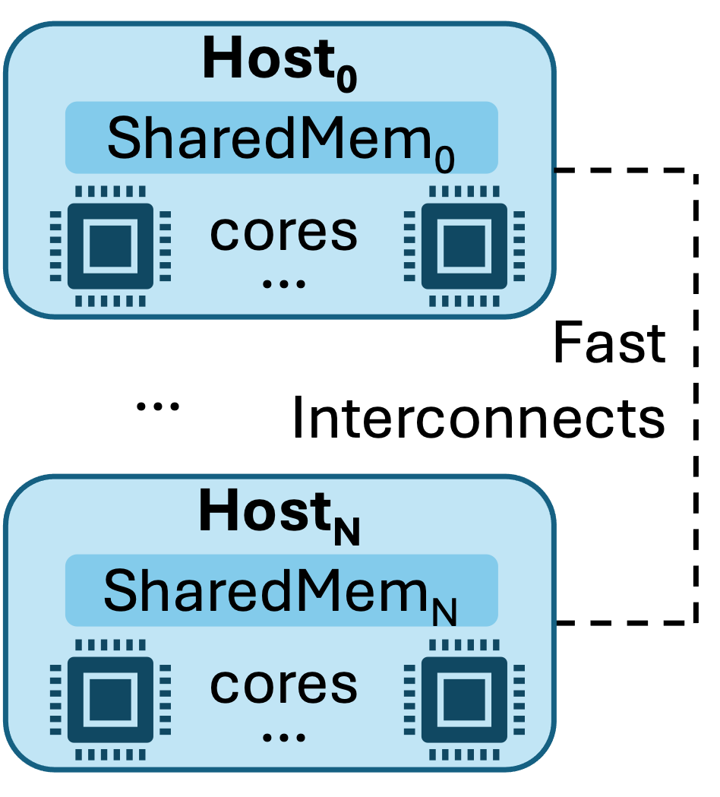
Future of Extended NUMA Architectures

Slide 150

Implementation
Written in Rust, extends NrOS
DiNOS*
Basic features functional
Distributed processes
Scheduling with locality
DiNOS
DCM Scheduler & simulator written in Java
Extended example for LD-NR; manage per-process page tables

Slide 151
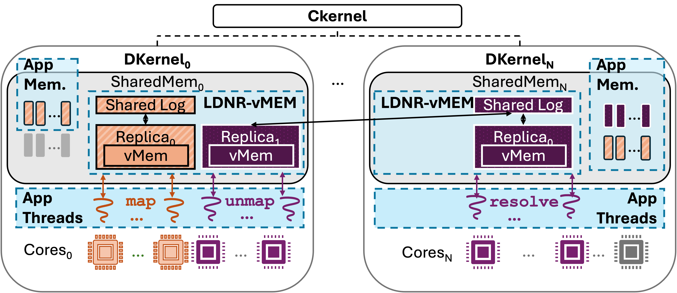

Slide 154
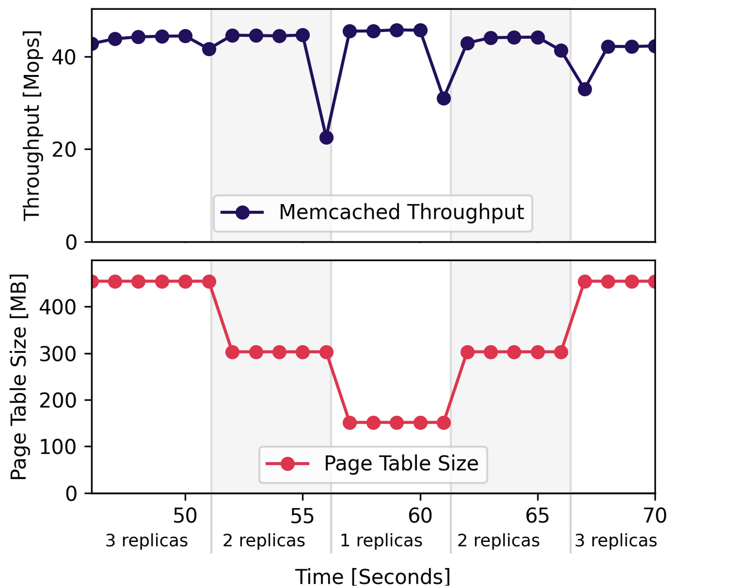
LD-NR in DiNOS

Slide 155
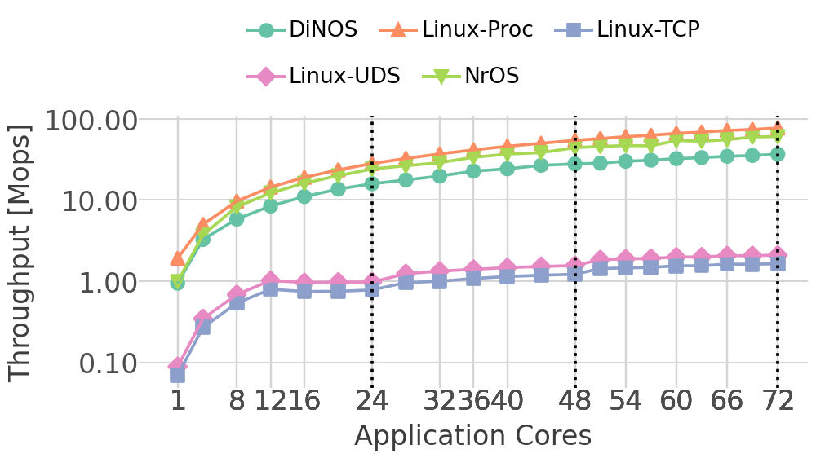
Scaling in DiNOS

Slide 156
Scaling in DiNOS

Slide 157
Scaling in DiNOS

Slide 158
Scaling in DiNOS

Slide 159
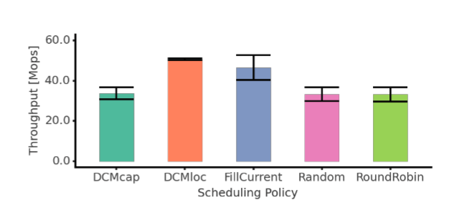

Slide 160
Serverless App
ML App
Application
4
1
Extensions to IRON
Programming Interface
Freshen
State Lifecycle
Serverless Framework
Framework
Container Runtime
Runtime
2
Escra
Auto-scaling
3
Linux
DiNOS
Operating System
LD-NR
Dynamic Replication
Hardware
CPU
CPU
NPU
Mem
Interconnect
Mem
Agenda: LD-NR/DiNOS

Slide 161
Serverless App
ML App
Application
4
1
Extensions to IRON
Programming Interface
Freshen
State Lifecycle
Serverless Framework
Framework
Container Runtime
Runtime
2
Escra
Auto-scaling
3
Linux
DiNOS
Operating System
LD-NR
Dynamic Replication
Hardware
CPU
CPU
NPU
Mem
Interconnect
Mem
Agenda: Extensions to IRON

Slide 162
Programming Abstractions for AMD XDNATM NPUs
Low level of abstraction
High level of abstraction
IRON
Efficiency
Expressivity
Extensibility

Slide 163
Agenda
Background
AMD XDNATM NPUs
IRON
Extensions to IRON
Example program
Evaluation
Future Work

Slide 164
Agenda
Background
AMD XDNATM NPUs
IRON
Extensions to IRON
Example program
Evaluation
Future Work

Slide 165
Background on AMD XDNATM NPUs
The Neural Processing Unit (NPU)

Slide 166
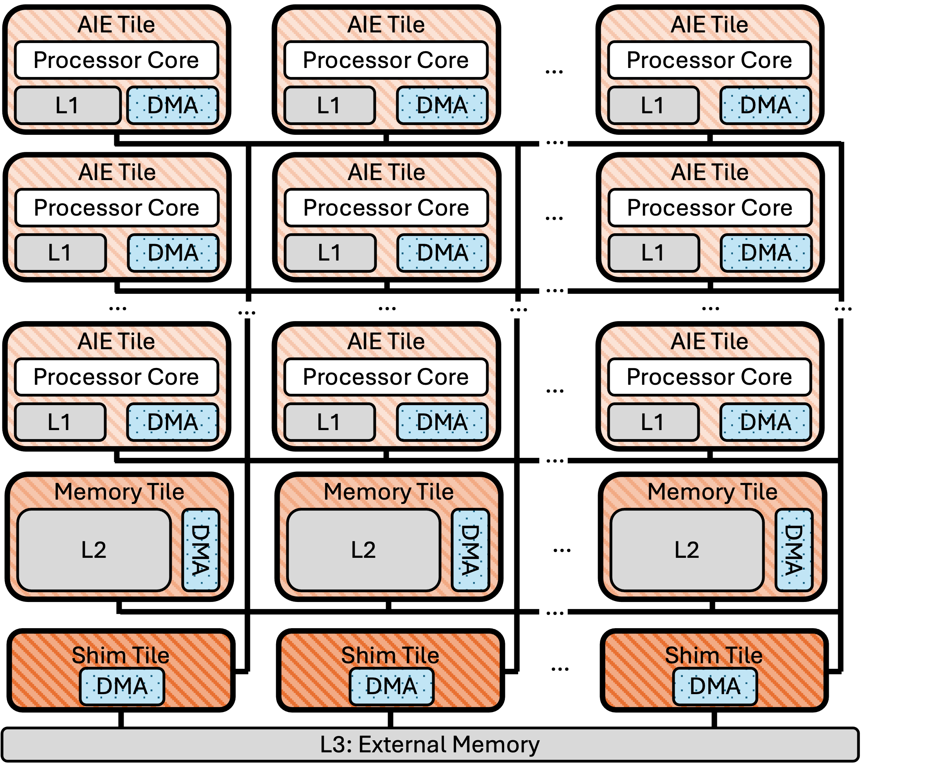
Background on AMD XDNATM NPUs
The Neural Processing Unit (NPU)

Slide 167
AI Engine
(AIE) array
Compute Tiles
Memory
(Mem) Tiles
Shim Tiles

Slide 168
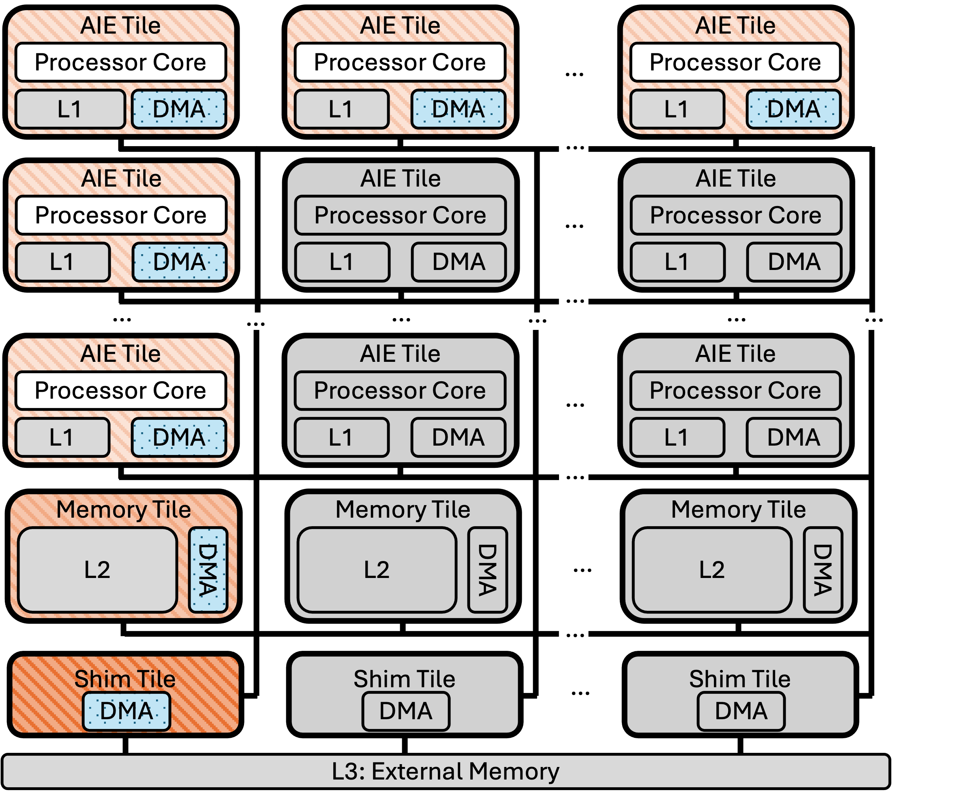
Spatially distributed compute and memory

Slide 169
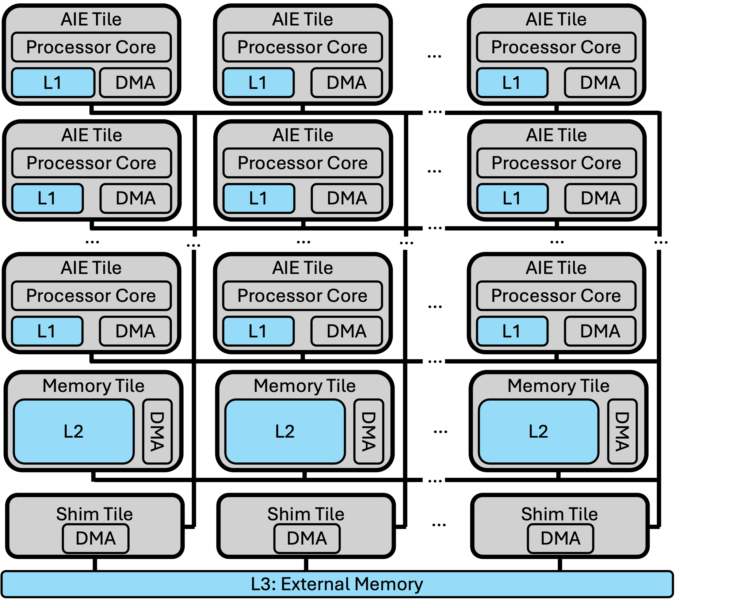
Spatially distributed compute and memory
Multi-level memory hierarchy

Slide 170
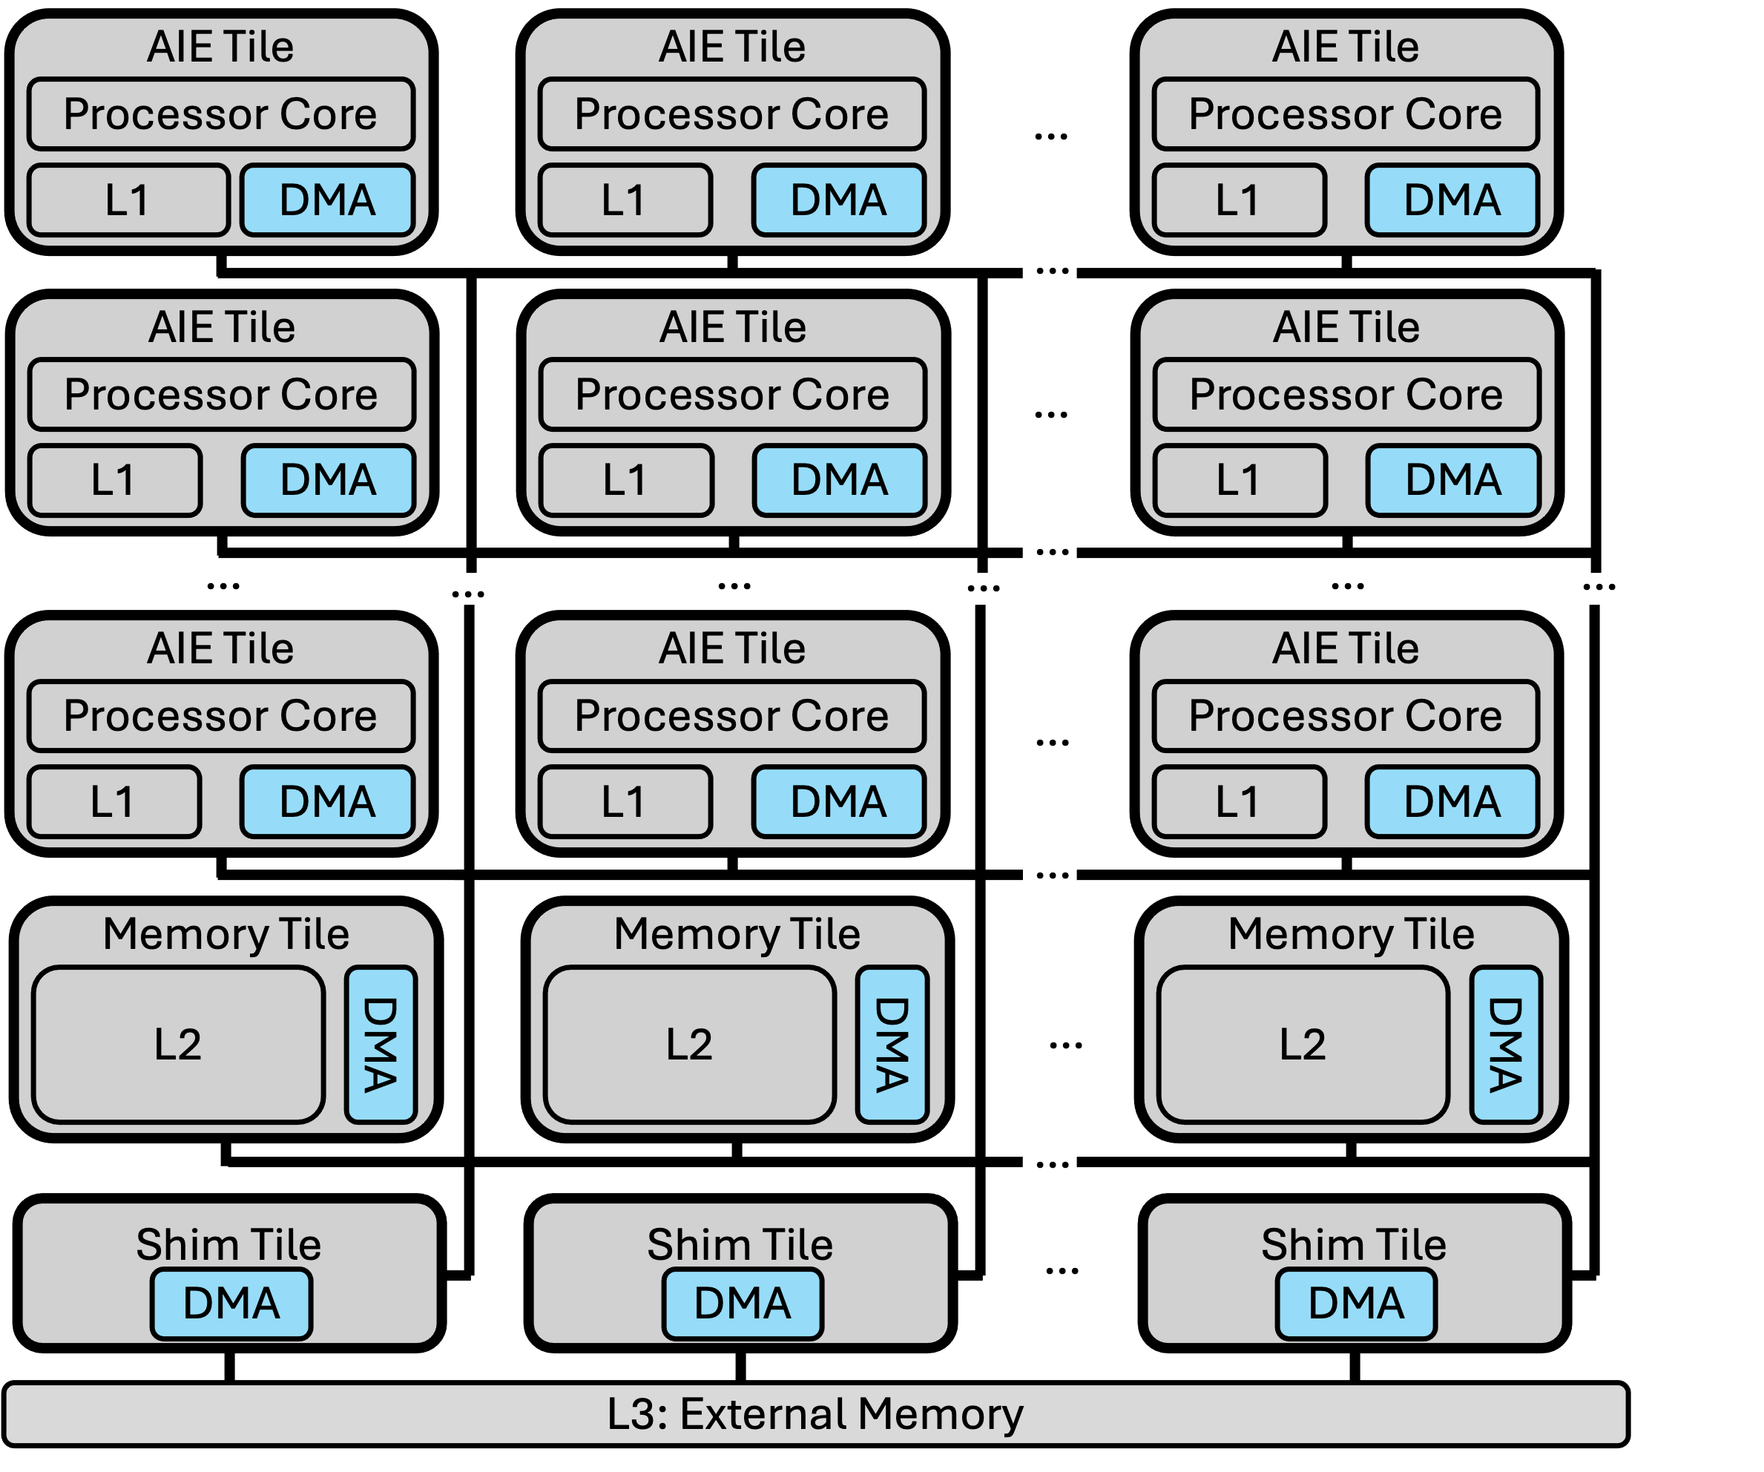
Spatially distributed compute and memory
Multi-level memory hierarchy
Explicitly scheduled data movement

Slide 171
Spatially distributed compute and memory
Multi-level memory hierarchy
Explicitly scheduled data movement
Data Movement Accelerators (DMA)

Slide 172
An NPU design needs…
Synchronization
Dataflow
Runtime operations

Slide 173
An NPU design needs…
Low level of abstraction
High level of abstraction
IRON
Synchronization
Dataflow
Runtime operations

Slide 174
An NPU design needs…
Low level of abstraction
High level of abstraction
IRON
Synchronization
Dataflow
Runtime operations
Exercise hardware features
Performance engineers
Research & education

Slide 175




IRON: Open-source toolkit for AMD XDNATM NPUs
Many details out of scope but described in paper or IRON programming guide.
MLIR-AIE dialect
Python API
Example Programs
Programming Guide
Notes:
IRON = Interface Representation for hands-ON close-to-metal programming of the AIE-array
Both useful, also useful for education
TODO: what is MLIR? What is MLIR-AIE?
Transition to next slide: Why do we want IRON?

Slide 176

IRON Example: Matrix Scalar Add
https://github.com/Xilinx/mlir-aie/tree/main/programming_examples/basic/matrix_scalar_add
Matrix
(Tensor)
In Data Movement
+N
Element-wise scalar addition
Tile
(Sub-tensor)
Out Data Movement

Slide 177
with mlir_mod_ctx() as ctx:
@device(AIEDevice.npu1_1col)
def device_body():
mty = np.ndarray[(MH, MW), np.dtype[np.int32]]
tty = np.ndarray[(TH, TW), np.dtype[np.int32]]
shm0 = tile(0, 0)
aie2 = tile(0, 2)
fi = object_fifo("in", shm0, aie2, 2, tty)
fo = object_fifo("out", aie2, shm0, 2, tty)
@core(aie2)
def core_body():
for _ in range_(sys.maxsize):
a = fi.acquire(ObjectFifoPort.Consume, 1)
b = fo.acquire(ObjectFifoPort.Produce, 1)
for i in range_(TH):
for j in range_(TW):
b[i, j] = a[i, j] + 1
fi.release(ObjectFifoPort.Consume, 1)
fo.release(ObjectFifoPort.Produce, 1)
@runtime_sequence(mty, mty)
def sequence(dati, dato):
in_task = shim_dma_single_bd_task(fi, dati,
sizes=[1, 1, TH, TW],
strides=[0, 0, MW, 1])
out_task = shim_dma_single_bd_task(fo, dato,
sizes=[1, 1, TH, TW],
strides=[0, 0, MW, 1],
issue_token=True)
dma_start_task(in_task, out_task)
dma_await_task(out_task)
dma_free_task(in_task)
print(ctx.module)

Slide 178
with mlir_mod_ctx() as ctx:
@device(AIEDevice.npu1_1col)
def device_body():
mty = np.ndarray[(MH, MW), np.dtype[np.int32]]
tty = np.ndarray[(TH, TW), np.dtype[np.int32]]
shm0 = tile(0, 0)
aie2 = tile(0, 2)
fi = object_fifo("in", shm0, aie2, 2, tty)
fo = object_fifo("out", aie2, shm0, 2, tty)
@core(aie2)
def core_body():
for _ in range_(sys.maxsize):
a = fi.acquire(ObjectFifoPort.Consume, 1)
b = fo.acquire(ObjectFifoPort.Produce, 1)
for i in range_(TH):
for j in range_(TW):
b[i, j] = a[i, j] + 1
fi.release(ObjectFifoPort.Consume, 1)
fo.release(ObjectFifoPort.Produce, 1)
@runtime_sequence(mty, mty)
def sequence(dati, dato):
in_task = shim_dma_single_bd_task(fi, dati,
sizes=[1, 1, TH, TW],
strides=[0, 0, MW, 1])
out_task = shim_dma_single_bd_task(fo, dato,
sizes=[1, 1, TH, TW],
strides=[0, 0, MW, 1],
issue_token=True)
dma_start_task(in_task, out_task)
dma_await_task(out_task)
dma_free_task(in_task)
print(ctx.module)
Types and Resources

Slide 179
with mlir_mod_ctx() as ctx:
@device(AIEDevice.npu1_1col)
def device_body():
mty = np.ndarray[(MH, MW), np.dtype[np.int32]]
tty = np.ndarray[(TH, TW), np.dtype[np.int32]]
shm0 = tile(0, 0)
aie2 = tile(0, 2)
fi = object_fifo("in", shm0, aie2, 2, tty)
fo = object_fifo("out", aie2, shm0, 2, tty)
@core(aie2)
def core_body():
for _ in range_(sys.maxsize):
a = fi.acquire(ObjectFifoPort.Consume, 1)
b = fo.acquire(ObjectFifoPort.Produce, 1)
for i in range_(TH):
for j in range_(TW):
b[i, j] = a[i, j] + 1
fi.release(ObjectFifoPort.Consume, 1)
fo.release(ObjectFifoPort.Produce, 1)
@runtime_sequence(mty, mty)
def sequence(dati, dato):
in_task = shim_dma_single_bd_task(fi, dati,
sizes=[1, 1, TH, TW],
strides=[0, 0, MW, 1])
out_task = shim_dma_single_bd_task(fo, dato,
sizes=[1, 1, TH, TW],
strides=[0, 0, MW, 1],
issue_token=True)
dma_start_task(in_task, out_task)
dma_await_task(out_task)
dma_free_task(in_task)
print(ctx.module)
Dataflow with ObjectFIFOs
Name, Source, Dest., Depth, Type

Slide 180
with mlir_mod_ctx() as ctx:
@device(AIEDevice.npu1_1col)
def device_body():
mty = np.ndarray[(MH, MW), np.dtype[np.int32]]
tty = np.ndarray[(TH, TW), np.dtype[np.int32]]
shm0 = tile(0, 0)
aie2 = tile(0, 2)
fi = object_fifo("in", shm0, aie2, 2, tty)
fo = object_fifo("out", aie2, shm0, 2, tty)
@core(aie2)
def core_body():
for _ in range_(sys.maxsize):
a = fi.acquire(ObjectFifoPort.Consume, 1)
b = fo.acquire(ObjectFifoPort.Produce, 1)
for i in range_(TH):
for j in range_(TW):
b[i, j] = a[i, j] + 1
fi.release(ObjectFifoPort.Consume, 1)
fo.release(ObjectFifoPort.Produce, 1)
@runtime_sequence(mty, mty)
def sequence(dati, dato):
in_task = shim_dma_single_bd_task(fi, dati,
sizes=[1, 1, TH, TW],
strides=[0, 0, MW, 1])
out_task = shim_dma_single_bd_task(fo, dato,
sizes=[1, 1, TH, TW],
strides=[0, 0, MW, 1],
issue_token=True)
dma_start_task(in_task, out_task)
dma_await_task(out_task)
dma_free_task(in_task)
print(ctx.module)
Per-AIE core program
Dataflow + Kernel

Slide 181
with mlir_mod_ctx() as ctx:
@device(AIEDevice.npu1_1col)
def device_body():
mty = np.ndarray[(MH, MW), np.dtype[np.int32]]
tty = np.ndarray[(TH, TW), np.dtype[np.int32]]
shm0 = tile(0, 0)
aie2 = tile(0, 2)
fi = object_fifo("in", shm0, aie2, 2, tty)
fo = object_fifo("out", aie2, shm0, 2, tty)
@core(aie2)
def core_body():
for _ in range_(sys.maxsize):
a = fi.acquire(ObjectFifoPort.Consume, 1)
b = fo.acquire(ObjectFifoPort.Produce, 1)
for i in range_(TH):
for j in range_(TW):
b[i, j] = a[i, j] + 1
fi.release(ObjectFifoPort.Consume, 1)
fo.release(ObjectFifoPort.Produce, 1)
@runtime_sequence(mty, mty)
def sequence(dati, dato):
in_task = shim_dma_single_bd_task(fi, dati,
sizes=[1, 1, TH, TW],
strides=[0, 0, MW, 1])
out_task = shim_dma_single_bd_task(fo, dato,
sizes=[1, 1, TH, TW],
strides=[0, 0, MW, 1],
issue_token=True)
dma_start_task(in_task, out_task)
dma_await_task(out_task)
dma_free_task(in_task)
print(ctx.module)
Input data
Output data

Slide 182
with mlir_mod_ctx() as ctx:
@device(AIEDevice.npu1_1col)
def device_body():
mty = np.ndarray[(MH, MW), np.dtype[np.int32]]
tty = np.ndarray[(TH, TW), np.dtype[np.int32]]
shm0 = tile(0, 0)
aie2 = tile(0, 2)
fi = object_fifo("in", shm0, aie2, 2, tty)
fo = object_fifo("out", aie2, shm0, 2, tty)
@core(aie2)
def core_body():
for _ in range_(sys.maxsize):
a = fi.acquire(ObjectFifoPort.Consume, 1)
b = fo.acquire(ObjectFifoPort.Produce, 1)
for i in range_(TH):
for j in range_(TW):
b[i, j] = a[i, j] + 1
fi.release(ObjectFifoPort.Consume, 1)
fo.release(ObjectFifoPort.Produce, 1)
@runtime_sequence(mty, mty)
def sequence(dati, dato):
in_task = shim_dma_single_bd_task(fi, dati,
sizes=[1, 1, TH, TW],
strides=[0, 0, MW, 1])
out_task = shim_dma_single_bd_task(fo, dato,
sizes=[1, 1, TH, TW],
strides=[0, 0, MW, 1],
issue_token=True)
dma_start_task(in_task, out_task)
dma_await_task(out_task)
dma_free_task(in_task)
print(ctx.module)
Tile Width (TW)
Tile
Height
(TH)
Tile
(Sub-tensor)
Matrix
Height
(MH)
Matrix Width (MW)

Slide 183
Recall, an NPU design needs…
Synchronization
Dataflow
Runtime operations
with mlir_mod_ctx() as ctx:
@device(AIEDevice.npu1_1col)
def device_body():
mty = np.ndarray[(MH, MW), np.dtype[np.int32]]
tty = np.ndarray[(TH, TW), np.dtype[np.int32]]
shm0 = tile(0, 0)
aie2 = tile(0, 2)
fi = object_fifo("in", shm0, aie2, 2, tty)
fo = object_fifo("out", aie2, shm0, 2, tty)
@core(aie2)
def core_body():
for _ in range_(sys.maxsize):
a = fi.acquire(ObjectFifoPort.Consume, 1)
b = fo.acquire(ObjectFifoPort.Produce, 1)
for i in range_(TH):
for j in range_(TW):
b[i, j] = a[i, j] + 1
fi.release(ObjectFifoPort.Consume, 1)
fo.release(ObjectFifoPort.Produce, 1)
@runtime_sequence(mty, mty)
def sequence(dati, dato):
in_task = shim_dma_single_bd_task(fi, dati,
sizes=[1, 1, TH, TW],
strides=[0, 0, MW, 1])
out_task = shim_dma_single_bd_task(fo, dato,
sizes=[1, 1, TH, TW],
strides=[0, 0, MW, 1],
issue_token=True)
dma_start_task(in_task, out_task)
dma_await_task(out_task)
dma_free_task(in_task)
print(ctx.module)

Slide 184
Recall, an NPU design needs…
Synchronization
Dataflow
Runtime operations
with mlir_mod_ctx() as ctx:
@device(AIEDevice.npu1_1col)
def device_body():
mty = np.ndarray[(MH, MW), np.dtype[np.int32]]
tty = np.ndarray[(TH, TW), np.dtype[np.int32]]
shm0 = tile(0, 0)
aie2 = tile(0, 2)
fi = object_fifo("in", shm0, aie2, 2, tty)
fo = object_fifo("out", aie2, shm0, 2, tty)
@core(aie2)
def core_body():
for _ in range_(sys.maxsize):
a = fi.acquire(ObjectFifoPort.Consume, 1)
b = fo.acquire(ObjectFifoPort.Produce, 1)
for i in range_(TH):
for j in range_(TW):
b[i, j] = a[i, j] + 1
fi.release(ObjectFifoPort.Consume, 1)
fo.release(ObjectFifoPort.Produce, 1)
@runtime_sequence(mty, mty)
def sequence(dati, dato):
in_task = shim_dma_single_bd_task(fi, dati,
sizes=[1, 1, TH, TW],
strides=[0, 0, MW, 1])
out_task = shim_dma_single_bd_task(fo, dato,
sizes=[1, 1, TH, TW],
strides=[0, 0, MW, 1],
issue_token=True)
dma_start_task(in_task, out_task)
dma_await_task(out_task)
dma_free_task(in_task)
print(ctx.module)

Slide 185
with mlir_mod_ctx() as ctx:
@device(AIEDevice.npu1_1col)
def device_body():
mty = np.ndarray[(MH, MW), np.dtype[np.int32]]
tty = np.ndarray[(TH, TW), np.dtype[np.int32]]
shm0 = tile(0, 0)
aie2 = tile(0, 2)
fi = object_fifo("in", shm0, aie2, 2, tty)
fo = object_fifo("out", aie2, shm0, 2, tty)
@core(aie2)
def core_body():
for _ in range_(sys.maxsize):
a = fi.acquire(ObjectFifoPort.Consume, 1)
b = fo.acquire(ObjectFifoPort.Produce, 1)
for i in range_(TH):
for j in range_(TW):
b[i, j] = a[i, j] + 1
fi.release(ObjectFifoPort.Consume, 1)
fo.release(ObjectFifoPort.Produce, 1)
@runtime_sequence(mty, mty)
def sequence(dati, dato):
in_task = shim_dma_single_bd_task(fi, dati,
sizes=[1, 1, TH, TW],
strides=[0, 0, MW, 1])
out_task = shim_dma_single_bd_task(fo, dato,
sizes=[1, 1, TH, TW],
strides=[0, 0, MW, 1],
issue_token=True)
dma_start_task(in_task, out_task)
dma_await_task(out_task)
dma_free_task(in_task)
print(ctx.module)
Efficiency
Read, write, modify designs
Only provide detail in areas of interest
Expressivity
Do not compromise on designer’s explicit control of hardware
Extensibility
Custom tooling, reusable logic
Notes:
Functional, reflects device closely.
But this is the minimal amount of information, which is still rather high for what is otherwise a simple program
Can create completely new abstractions with new API at higher level of abstraction – but want to keep control, just make simpler.

Slide 186
with mlir_mod_ctx() as ctx:
@device(AIEDevice.npu1_1col)
def device_body():
mty = np.ndarray[(MH, MW), np.dtype[np.int32]]
tty = np.ndarray[(TH, TW), np.dtype[np.int32]]
shm0 = tile(0, 0)
aie2 = tile(0, 2)
fi = object_fifo("in", shm0, aie2, 2, tty)
fo = object_fifo("out", aie2, shm0, 2, tty)
@core(aie2)
def core_body():
for _ in range_(sys.maxsize):
a = fi.acquire(ObjectFifoPort.Consume, 1)
b = fo.acquire(ObjectFifoPort.Produce, 1)
for i in range_(TH):
for j in range_(TW):
b[i, j] = a[i, j] + 1
fi.release(ObjectFifoPort.Consume, 1)
fo.release(ObjectFifoPort.Produce, 1)
@runtime_sequence(mty, mty)
def sequence(dati, dato):
in_task = shim_dma_single_bd_task(fi, dati,
sizes=[1, 1, TH, TW],
strides=[0, 0, MW, 1])
out_task = shim_dma_single_bd_task(fo, dato,
sizes=[1, 1, TH, TW],
strides=[0, 0, MW, 1],
issue_token=True)
dma_start_task(in_task, out_task)
dma_await_task(out_task)
dma_free_task(in_task)
print(ctx.module)
Efficiency
Read, write, modify designs
Only provide detail in areas of interest
Expressivity
Do not compromise on designer’s explicit control of hardware
Extensibility
Custom tooling, reusable logic
Notes:
Functional, reflects device closely.
But this is the minimal amount of information, which is still rather high for what is otherwise a simple program
Can create completely new abstractions with new API at higher level of abstraction – but want to keep control, just make simpler.

Slide 187
with mlir_mod_ctx() as ctx:
@device(AIEDevice.npu1_1col)
def device_body():
mty = np.ndarray[(MH, MW), np.dtype[np.int32]]
tty = np.ndarray[(TH, TW), np.dtype[np.int32]]
shm0 = tile(0, 0)
aie2 = tile(0, 2)
fi = object_fifo("in", shm0, aie2, 2, tty)
fo = object_fifo("out", aie2, shm0, 2, tty)
@core(aie2)
def core_body():
for _ in range_(sys.maxsize):
a = fi.acquire(ObjectFifoPort.Consume, 1)
b = fo.acquire(ObjectFifoPort.Produce, 1)
for i in range_(TH):
for j in range_(TW):
b[i, j] = a[i, j] + 1
fi.release(ObjectFifoPort.Consume, 1)
fo.release(ObjectFifoPort.Produce, 1)
@runtime_sequence(mty, mty)
def sequence(dati, dato):
in_task = shim_dma_single_bd_task(fi, dati,
sizes=[1, 1, TH, TW],
strides=[0, 0, MW, 1])
out_task = shim_dma_single_bd_task(fo, dato,
sizes=[1, 1, TH, TW],
strides=[0, 0, MW, 1],
issue_token=True)
dma_start_task(in_task, out_task)
dma_await_task(out_task)
dma_free_task(in_task)
print(ctx.module)
Efficiency
Read, write, modify designs
Only provide detail in areas of interest
Expressivity
Do not compromise on designer’s explicit control of hardware
Extensibility
Custom tooling, reusable logic
Notes:
Functional, reflects device closely.
But this is the minimal amount of information, which is still rather high for what is otherwise a simple program
Can create completely new abstractions with new API at higher level of abstraction – but want to keep control, just make simpler.

Slide 188
with mlir_mod_ctx() as ctx:
@device(AIEDevice.npu1_1col)
def device_body():
mty = np.ndarray[(MH, MW), np.dtype[np.int32]]
tty = np.ndarray[(TH, TW), np.dtype[np.int32]]
shm0 = tile(0, 0)
aie2 = tile(0, 2)
fi = object_fifo("in", shm0, aie2, 2, tty)
fo = object_fifo("out", aie2, shm0, 2, tty)
@core(aie2)
def core_body():
for _ in range_(sys.maxsize):
a = fi.acquire(ObjectFifoPort.Consume, 1)
b = fo.acquire(ObjectFifoPort.Produce, 1)
for i in range_(TH):
for j in range_(TW):
b[i, j] = a[i, j] + 1
fi.release(ObjectFifoPort.Consume, 1)
fo.release(ObjectFifoPort.Produce, 1)
@runtime_sequence(mty, mty)
def sequence(dati, dato):
in_task = shim_dma_single_bd_task(fi, dati,
sizes=[1, 1, TH, TW],
strides=[0, 0, MW, 1])
out_task = shim_dma_single_bd_task(fo, dato,
sizes=[1, 1, TH, TW],
strides=[0, 0, MW, 1],
issue_token=True)
dma_start_task(in_task, out_task)
dma_await_task(out_task)
dma_free_task(in_task)
print(ctx.module)
Efficiency
Read, write, modify designs
Only provide detail in areas of interest
Expressivity
Do not compromise on designer’s explicit control of hardware
Extensibility
Custom tooling, reusable logic
Notes:
Functional, reflects device closely.
But this is the minimal amount of information, which is still rather high for what is otherwise a simple program
Can create completely new abstractions with new API at higher level of abstraction – but want to keep control, just make simpler.

Slide 189
Agenda
Background
AMD XDNATM NPUs
IRON
Extensions to IRON
Example program
Evaluation
Future Work

Slide 190
Extensions to IRON
Key Technique:
Distance from MLIR
Enables:
Refined constructs
Defaults and extensions

Slide 191
Distance from MLIR
fi = object_fifo("in", shm0, aie2, 2, tty)
MLIR Python Bindings
MLIR

Slide 192
Distance from MLIR
ObjectFifo(tty)
Extensions to IRON
resolve()
fi = object_fifo("in", shm0, aie2, 2, tty)
MLIR Python Bindings
MLIR

Slide 193
Refined Constructs
Program
Worker
Runtime
ObjectFIFO

Slide 194
Refined Constructs
With Extensions
mty = np.ndarray[(MH, MW), np.dtype[np.int32]]
tty = np.ndarray[(TH, TW), np.dtype[np.int32]]
fi = ObjectFifo(tty)
fo = ObjectFifo(tty)
def core_fn(of_in, of_out):
a = of_in.acquire(1)
b = of_out.acquire(1)
for i in range_(TH):
for j in range_(TW):
b[i, j] = a[i, j] + 1
of_in.release(1)
of_out.release(1)
my_worker = Worker(core_fn,
fn_args=[fi.cons(), fo.prod()])
tap = TensorTiler2D.simple_tiler(
(MH, MW), (TH, TW))[0]
rt = Runtime()
with rt.sequence(mty, mty) as (dati, dato):
rt.start(my_worker)
rt.fill(fi.prod(), dati, tap)
rt.drain(fo.cons(), dato, tap, wait=True)
print(Program(NPU1Col1(),rt).resolve_program(
SequentialPlacer()))
Program
Worker
Runtime
ObjectFIFO

Slide 195
Refined Constructs
mty = np.ndarray[(MH, MW), np.dtype[np.int32]]
tty = np.ndarray[(TH, TW), np.dtype[np.int32]]
fi = ObjectFifo(tty)
fo = ObjectFifo(tty)
def core_fn(of_in, of_out):
a = of_in.acquire(1)
b = of_out.acquire(1)
for i in range_(TH):
for j in range_(TW):
b[i, j] = a[i, j] + 1
of_in.release(1)
of_out.release(1)
my_worker = Worker(core_fn,
fn_args=[fi.cons(), fo.prod()])
tap = TensorTiler2D.simple_tiler(
(MH, MW), (TH, TW))[0]
rt = Runtime()
with rt.sequence(mty, mty) as (dati, dato):
rt.start(my_worker)
rt.fill(fi.prod(), dati, tap)
rt.drain(fo.cons(), dato, tap, wait=True)
print(Program(NPU1Col1(),rt).resolve_program(
SequentialPlacer()))
Program
Worker
Runtime
ObjectFIFO

Slide 196
Refined Constructs
mty = np.ndarray[(MH, MW), np.dtype[np.int32]]
tty = np.ndarray[(TH, TW), np.dtype[np.int32]]
fi = ObjectFifo(tty)
fo = ObjectFifo(tty)
def core_fn(of_in, of_out):
a = of_in.acquire(1)
b = of_out.acquire(1)
for i in range_(TH):
for j in range_(TW):
b[i, j] = a[i, j] + 1
of_in.release(1)
of_out.release(1)
my_worker = Worker(core_fn,
fn_args=[fi.cons(), fo.prod()])
tap = TensorTiler2D.simple_tiler(
(MH, MW), (TH, TW))[0]
rt = Runtime()
with rt.sequence(mty, mty) as (dati, dato):
rt.start(my_worker)
rt.fill(fi.prod(), dati, tap)
rt.drain(fo.cons(), dato, tap, wait=True)
print(Program(NPU1Col1(),rt).resolve_program(
SequentialPlacer()))
Program
Worker
Runtime
ObjectFIFO

Slide 197
Refined Constructs
mty = np.ndarray[(MH, MW), np.dtype[np.int32]]
tty = np.ndarray[(TH, TW), np.dtype[np.int32]]
fi = ObjectFifo(tty)
fo = ObjectFifo(tty)
def core_fn(of_in, of_out):
a = of_in.acquire(1)
b = of_out.acquire(1)
for i in range_(TH):
for j in range_(TW):
b[i, j] = a[i, j] + 1
of_in.release(1)
of_out.release(1)
my_worker = Worker(core_fn,
fn_args=[fi.cons(), fo.prod()])
tap = TensorTiler2D.simple_tiler(
(MH, MW), (TH, TW))[0]
rt = Runtime()
with rt.sequence(mty, mty) as (dati, dato):
rt.start(my_worker)
rt.fill(fi.prod(), dati, tap)
rt.drain(fo.cons(), dato, tap, wait=True)
print(Program(NPU1Col1(),rt).resolve_program(
SequentialPlacer()))
Program
Worker
Runtime
ObjectFIFO

Slide 198
Refined Constructs
mty = np.ndarray[(MH, MW), np.dtype[np.int32]]
tty = np.ndarray[(TH, TW), np.dtype[np.int32]]
fi = ObjectFifo(tty)
fo = ObjectFifo(tty)
def core_fn(of_in, of_out):
a = of_in.acquire(1)
b = of_out.acquire(1)
for i in range_(TH):
for j in range_(TW):
b[i, j] = a[i, j] + 1
of_in.release(1)
of_out.release(1)
my_worker = Worker(core_fn,
fn_args=[fi.cons(), fo.prod()])
tap = TensorTiler2D.simple_tiler(
(MH, MW), (TH, TW))[0]
rt = Runtime()
with rt.sequence(mty, mty) as (dati, dato):
rt.start(my_worker)
rt.fill(fi.prod(), dati, tap)
rt.drain(fo.cons(), dato, tap, wait=True)
print(Program(NPU1Col1(),rt).resolve_program(
SequentialPlacer()))
Program
Worker
Runtime
ObjectFIFO

Slide 199
Extensibility
Placement
On-the-fly Data Transformations

Slide 200
Extensibility
mty = np.ndarray[(MH, MW), np.dtype[np.int32]]
tty = np.ndarray[(TH, TW), np.dtype[np.int32]]
fi = ObjectFifo(tty)
fo = ObjectFifo(tty)
def core_fn(of_in, of_out):
a = of_in.acquire(1)
b = of_out.acquire(1)
for i in range_(TH):
for j in range_(TW):
b[i, j] = a[i, j] + 1
of_in.release(1)
of_out.release(1)
my_worker = Worker(core_fn,
fn_args=[fi.cons(), fo.prod()])
tap = TensorTiler2D.simple_tiler(
(MH, MW), (TH, TW))[0]
rt = Runtime()
with rt.sequence(mty, mty) as (dati, dato):
rt.start(my_worker)
rt.fill(fi.prod(), dati, tap)
rt.drain(fo.cons(), dato, tap, wait=True)
print(Program(NPU1Col1(),rt).resolve_program(
SequentialPlacer()))
Placement
On-the-fly Data Transformations

Slide 201
Extensibility
mty = np.ndarray[(MH, MW), np.dtype[np.int32]]
tty = np.ndarray[(TH, TW), np.dtype[np.int32]]
fi = ObjectFifo(tty)
fo = ObjectFifo(tty)
def core_fn(of_in, of_out):
a = of_in.acquire(1)
b = of_out.acquire(1)
for i in range_(TH):
for j in range_(TW):
b[i, j] = a[i, j] + 1
of_in.release(1)
of_out.release(1)
my_worker = Worker(core_fn,
fn_args=[fi.cons(), fo.prod()])
tap = TensorTiler2D.simple_tiler(
(MH, MW), (TH, TW))[0]
rt = Runtime()
with rt.sequence(mty, mty) as (dati, dato):
rt.start(my_worker)
rt.fill(fi.prod(), dati, tap)
rt.drain(fo.cons(), dato, tap, wait=True)
print(Program(NPU1Col1(),rt).resolve_program(
SequentialPlacer()))
Placement
On-the-fly Data Transformations
tap: Tensor Access Pattern
tas: Tensor Access Sequence
More information in paper!

Slide 202
Agenda
Background
AMD XDNATM NPUs
IRON
Extensions to IRON
Example program
Evaluation
Future Work

Slide 203
27 Sample designs
Evaluation Goals: Efficiency, Expressivity, Extensibility
Imperfect metrics, but representative of trends
See paper for more details

Slide 204
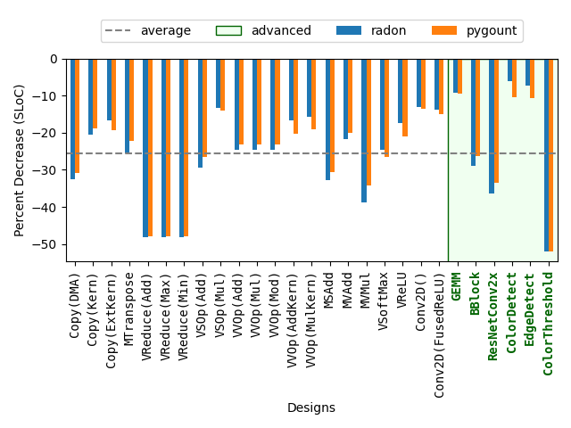
Designer Efficiency – Decrease in single lines of code (SLOC)

Slide 205
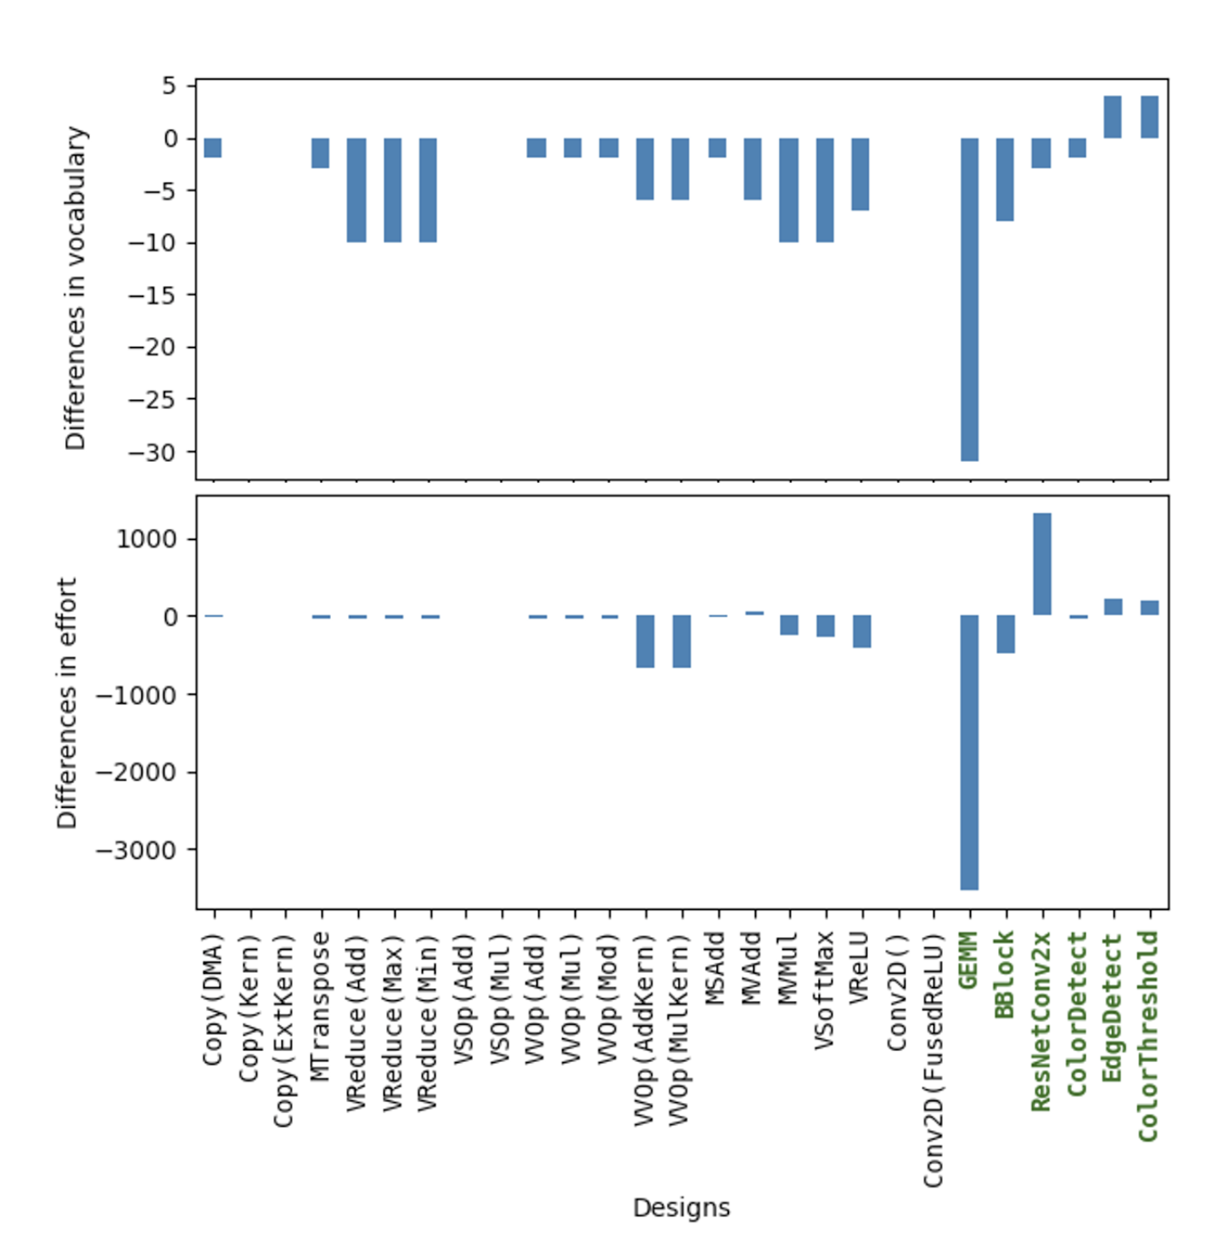
Designer Efficiency – Decreases in Halstead vocabulary (top) and effort (bottom)

Slide 206
SequentialPlacer
mty = np.ndarray[(MH, MW), np.dtype[np.int32]]
tty = np.ndarray[(TH, TW), np.dtype[np.int32]]
fi = ObjectFifo(tty)
fo = ObjectFifo(tty)
def core_fn(of_in, of_out):
a = of_in.acquire(1)
b = of_out.acquire(1)
for i in range_(TH):
for j in range_(TW):
b[i, j] = a[i, j] + 1
of_in.release(1)
of_out.release(1)
my_worker = Worker(core_fn,
fn_args=[fi.cons(), fo.prod()])
tap = TensorTiler2D.simple_tiler(
(MH, MW), (TH, TW))[0]
rt = Runtime()
with rt.sequence(mty, mty) as (dati, dato):
rt.start(my_worker)
rt.fill(fi.prod(), dati, tap)
rt.drain(fo.cons(), dato, tap, wait=True)
print(Program(NPU1Col1(),rt).resolve_program(
SequentialPlacer()))
24/27 examples
Notes:
Not fully aware of all resource limitations,
but could easily be extended.
Current implementation not complex enough

Slide 207
TensorTiler2D
mty = np.ndarray[(MH, MW), np.dtype[np.int32]]
tty = np.ndarray[(TH, TW), np.dtype[np.int32]]
fi = ObjectFifo(tty)
fo = ObjectFifo(tty)
def core_fn(of_in, of_out):
a = of_in.acquire(1)
b = of_out.acquire(1)
for i in range_(TH):
for j in range_(TW):
b[i, j] = a[i, j] + 1
of_in.release(1)
of_out.release(1)
my_worker = Worker(core_fn,
fn_args=[fi.cons(), fo.prod()])
tap = TensorTiler2D.simple_tiler(
(MH, MW), (TH, TW))[0]
rt = Runtime()
with rt.sequence(mty, mty) as (dati, dato):
rt.start(my_worker)
rt.fill(fi.prod(), dati, tap)
rt.drain(fo.cons(), dato, tap, wait=True)
print(Program(NPU1Col1(),rt).resolve_program(
SequentialPlacer()))
5 designs

Slide 208
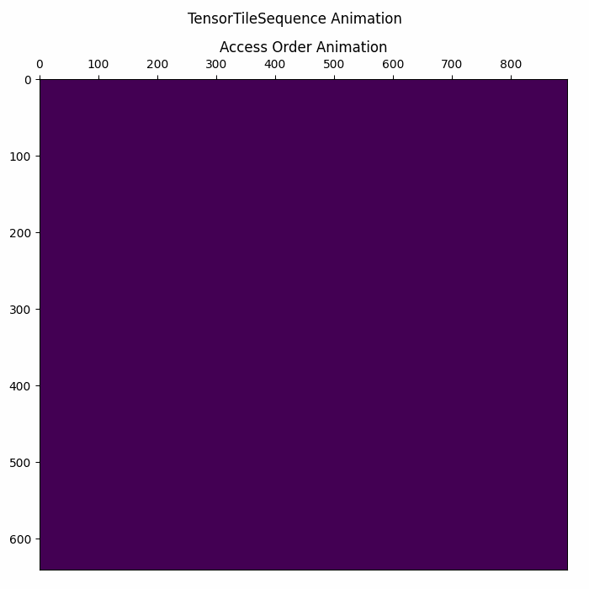


Matrix Multiplication Visualization of Runtime DMA Ops
https://github.com/Xilinx/mlir-aie/blob/main/programming_examples/basic/matrix_multiplication/whole_array/mat_mul_whole_array_visualization.ipynb
A Runtime DMA Pattern
B Runtime DMA Pattern
C Runtime DMA Pattern
Note: Timing between animations is not coordinated

Slide 209
Agenda
Background
AMD XDNATM NPUs
IRON
Extensions to IRON
Example program
Evaluation
Future Work

Slide 210
Future Work
Extend further
Currently integrated and available!
Improvements:
1) Debugging, tracing
2) Data visualizations
3) …
Enable related works
ObjectFIFO analysis
Analyze similarities to other platforms
Support advanced designs

Slide 211
Serverless App
ML App
Application
4
1
Extensions to IRON
Programming Interface
Freshen
State Lifecycle
Serverless Framework
Framework
Container Runtime
Runtime
2
Escra
Auto-scaling
3
Linux
DiNOS
Operating System
LD-NR
Dynamic Replication
Hardware
CPU
CPU
NPU
Mem
Interconnect
Mem
Agenda: Extensions to IRON

Slide 212
Serverless App
ML App
Application
4
1
Extensions to IRON
Programming Interface
Freshen
State Lifecycle
Serverless Framework
Framework
Container Runtime
Runtime
2
Escra
Auto-scaling
3
Linux
DiNOS
Operating System
LD-NR
Dynamic Replication
Hardware
CPU
CPU
NPU
Mem
Interconnect
Mem
Summary

Slide 213
Thank you to my advisors & collaborators
Freshen: E. Hunhoff, S. Irshad, V. Thurimella, A. Tariq, and E. Rozner. 2021. “Proactive Serverless Function Resource Management” in Proceedings of the 2020 Sixth International Workshop on Serverless Computing (WoSC'20). Association for Computing Machinery, New York, NY, USA, 61–66. https://doi.org/10.1145/3429880.3430102
Escra: G. Cusack, M. Nazari, S. Goodarzy, E. Hunhoff, P. Oberai, E. Keller, E. Rozner, and R. Han. “Escra: Event-driven, Sub-second Container Resource Allocation” in 42nd IEEE International Conference on Distributed Computing Systems (ICDCS ‘22), 2022
LD-NR/DiNOS: OSDI Poster 2023 “An Operating System for Disaggregation with Coherence.” Full paper awaiting resubmission.
Extensions to IRON: E. Hunhoff et al., "Efficiency, Expressivity, and Extensibility in a Close-to-Metal NPU Programming Interface," 2025 IEEE 33rd Annual International Symposium on Field-Programmable Custom Computing Machines (FCCM), Fayetteville, AR, USA, 2025, pp. 85-94, doi: 10.1109/FCCM62733.2025.00043.

